Slide 1
GT-I9300 Appendix
Customer Consultant Guide
Android mobile technology platform
- Appendix-
Version 6.0
Global CS
ECC HHP Review
22nd June 2012

Slide 2
Revision History: This version replaces all previous versions
Date | Version | Comments
2012-06-01 | V1.0 | Initial version Slide 3 Regarding proximity sensor Slide 4 Regarding S-Voice Slide 5 Dropbox – Error for sharing my contacts Slide 6 Dropbox – How to use the fully storage Slide 7 Motion Slide 8 ChatOn Slide 9 Mass storage Mode
2012.06.01 | V2.0 | ECC HP Review for local English and Grammar Slide 5 – S Voice error message – slide updated with further notes and pictures Slide 5 and 6 added – further pictures regarding S voice error message Slide 8 – Dropbox slide redrafted for clarity Slides 9 to 13 added showing pictures of steps for Dropbox FAQ Slide 14 – pictures added for Turn over motion and Music Player app Slide 16 – text added regarding Tap and hold on Status bar to see Mass Storage device setting. Extra picture added for Portable device pop up
2012.06.08 | V3.0 | HQ additions: Slide 17 – USB Connection(MTP Mode) . We changed a comment. Because MTP mode is different Mass storage mode. Slide 18 – USB Connection(MTP Mode) . We changed a comment. Because MTP mode is different Mass storage mode. Slide 19 – Regarding “AllShare Cast” function. Slide 20 – Display noise Slide 21 – Swype Slide 22~ 24 – SMS transfer Slide 25 – Kies for MAC OS Slide 26 – Incognito Pages Slide 27 – Capture Feature

Slide 3
Revision History: This version replaces all previous versions
Date | Version
2012.06.11 | V3.1 | HQ additions: Slide 28 – HDMI Connector Slide 29 – Predictive text Slide 30 – Multi Coating(Evaporation) Slide 31 – Daylight Saving Icon Slide 32 – Call settings
2012.06.14 | V3.2 | HQ additions: Slide 33 – Music Player Slide 34 – Notification setting off Slide 35,36 – Wrong display of Message Shortcut icon Slide 37 - Picasa Sync Image
2012.06.15 | V3.2 | HQ additions: Slide 38,39 - 3*4 Keyboard usage Slide 40 - Voice Message button
2012.06.18 | V4.0 | ECC HP Review for local English and Grammar of updates in Versions 3.x (additions from CS team HQ) Slide 4 – additional Version history slide added Slide 21 – added slide regarding advice on how to update SW via KIES Slide 24 - added slide regarding different names for “Swype” keyboard feature Slides 25,26 & 27 regarding SMS transfer via Kies reworked for clarity Slide 28 – Kies for Mac OS slide reworked and pictures added Slide 30 – picture added showing “Anti Shake” setting in camera mode Slide 31 – Part number for GT-I9300 HDMI cable added Slide 32 – additional pictures added showing saved word in Predictive text list Slide 36 – Pictures added to the “how to access Call Settings” slide Slide 38 – Steps added for Message Icon problem slide

Slide 4
Revision History: This version replaces all previous versions
Date | Version
2012.06.18 | V4.0 Continued | Updates from CS team HQ added to Ver. 4.0 on 18th June 2012 Slide 44 - SMART View App (Text redrafted) Slide 45 - Home Key reaction speed (Picture added showing home key) Slide 46,47 - TSP sensitivity (Text simplified for both slides) Slide 48 – Home Key malfunction (note added to back up data to PC via Kies before Factory reset)
2012.06.20 | V5.0 | ECC HHP review of updates from CS team HQ supplied 20th June 2012 Update from CS team HQ: Slide 49 – “Message ringtone on Notification setting off” Slide 49 – “Message ringtone on Notification setting off –” text redrafted Also for this appendix: Slide 42 – note added on how turn off predictive text Slide 50 – slide added showing how to access the Quick Menu panel Slide 51 – slide added showing how to enable the “3 x 4” keyboard
2012.06.22 | V6.0 | ECC HHP review of updates from CS team HQ supplied 20th June 2012 Update from CS team HQ: Slide 52 – S-voice support language. Slide 52 – Text redrafted Also for this appendix: Slide 53 added – what is “Pop up play” Source: http://www.samsung.com/uk/consumer/mobile-devices/smartphones/android/GT-I9300MBDBTU-features Slides 54 to 57 added – How to use the “Pop up play” feature

Slide 5
Revision History: This version replaces all previous versions
Date | Version
2012.06.25 | V6.1 | HQ additions: Slide 59 – Camera open fail Slide 60,61 – Volume during voice call Slide 62,63 – Show pointer location of Developer options

Slide 6
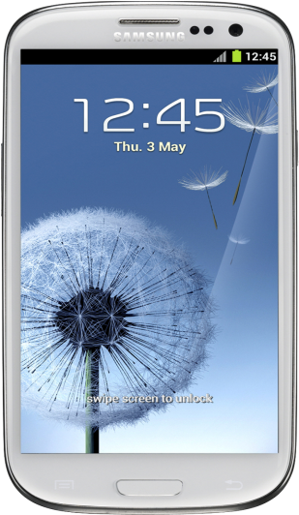
Regarding proximity sensor
Q : My device screen did not turn back on after I had been talking on the phone.
What should I do?
A : The Proximity Sensor performance
can be influenced by a “smudge”.
(e.g. from Sweat, Cosmetics etc)
Keep the upper side of your phone clean to
get a stable performance.
Note: To turn off the proximity sensor:
1. In the application list, select Phone.
2. Press the Option key and select Call settings.
3. Select “Auto screen off during calls”
Proximity Sensor

Slide 7
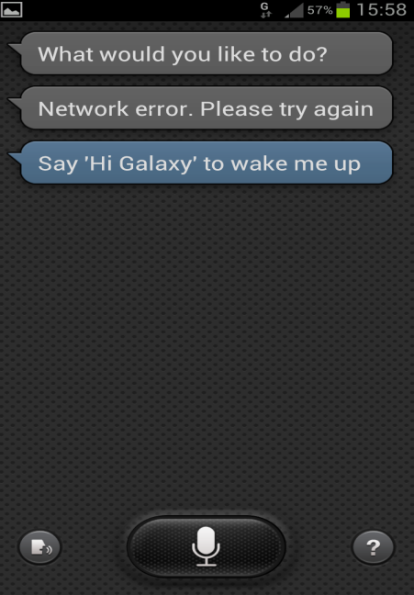
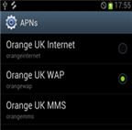
Regarding S-Voice - Operator Orange / UK region (1/3)
Q : When using an Orange SIM card with my GT-I9300, the S-Voice is not working.
What should I do?
A : To use S-Voice, please check the APN (Access Point Name) is set correct. Follow the steps below.
1. Go to Settings menu.
2. Select More settings.
3. Select Mobile networks.
4. Change the APN setting from “Orange UK WAP” to “Orange UK Internet”
If, on inserting Orange SIM, the default APN value is “Orange UK WAP”,
it should be changed to “Orange UK Internet”
to enable S-Voice to function
Currently, only Orange operator affected.
Correct setting
Incorrect setting
Note 1: the device is NOT faulty.
Note 2: Where the wrong APN has been selected, this may also cause other applications to give a similar error message
If so – please use advice above to check APN set correctly.
For more pictures and notes please see following slides

Slide 8
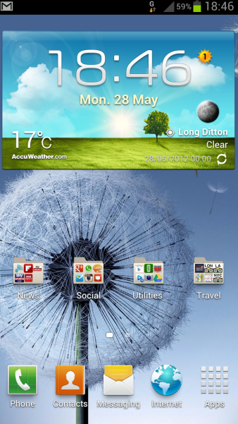
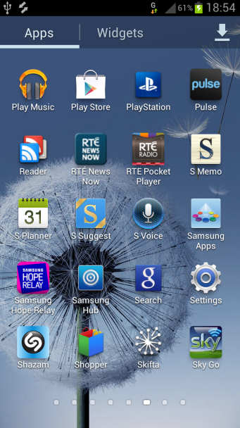
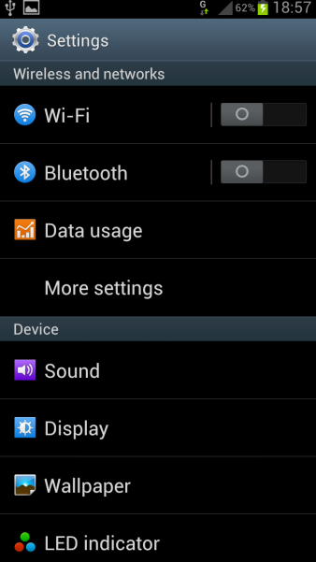
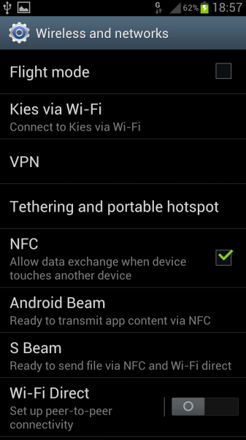
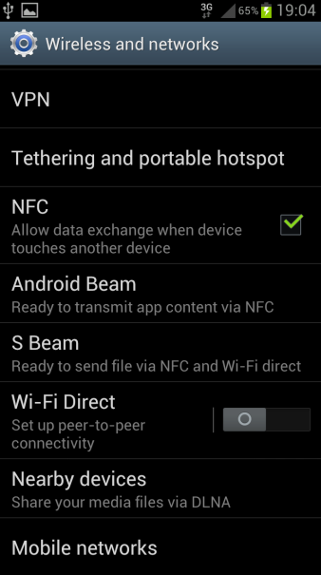
Regarding S-Voice - Operator Orange / UK region (2/3)
Q : When using an Orange SIM with my GT-I9300, the S-Voice is not working.
What should I do?
A : To use S-Voice, please check the APN (Access Point Name) is set correct. Follow the steps below.
1.Select Apps
2.Scroll left and select Settings from Apps
menu
3.Select More
settings
4.Scroll to the bottom
of the Settings area
5.Select Mobile
networks
Continued next slide

Slide 9
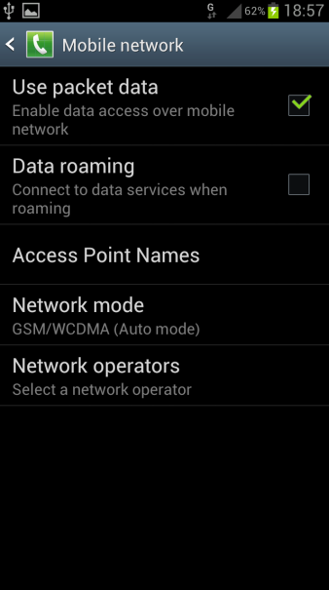
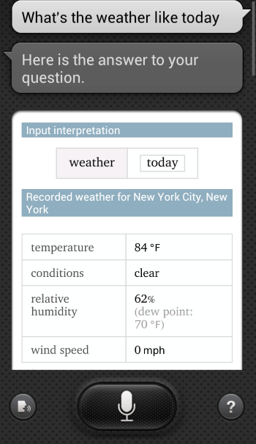
Regarding S-Voice - Operator Orange / UK region (3/3)
Q : When using an Orange SIM with my GT-I9300, the S-Voice is not working.
What should I do?
A : To use S-Voice, please check the APN (Access Point Name) is set correct. Follow the steps below.
6.Select Access
Point Names
7.Orange UK WAP is currently selected
8.Select Orange UK
Internet
9. Once the APN
setting has been
changed, exit the
Settings area and try
the S Voice feature
again
S Voice will now work correctly

Slide 10
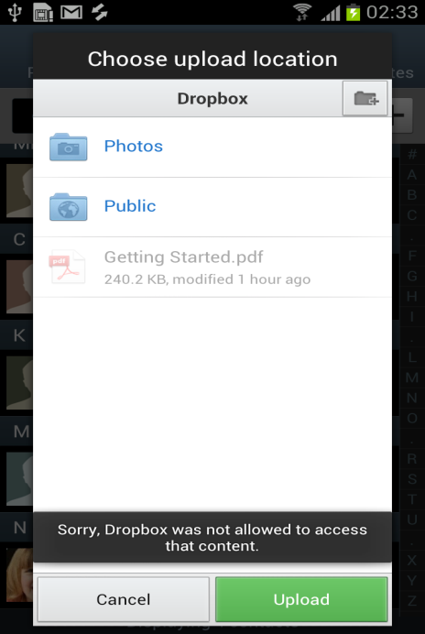
Dropbox – Error for sharing my contacts
Q: When I share my contacts through the "Dropbox"
application, an error popup is displayed.
What should I do ?
A: Your device is not faulty.
The "Dropbox" application
has no authority to access contacts list.
Error Pop up

Slide 11
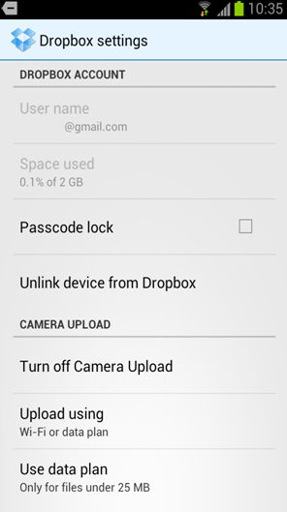
Dropbox – How to upgrade from 2GB to 50GB of space
Q: After I set up the Dropbox app on my GT-I9300 device, when I
checked the settings I saw I had only 2GB of space available.
However I thought there was supposed to be 50GB of space
available. Is there a fault?
No, there is no fault. To get your allocation
of 50GB, please see the steps below:
1. On your PC please visit http://www.dropbox.com
2. Sign in with the account details used to create the
account on your GT-I9300 device
3. Go the area ““Get Started”
4. Complete the required functions
See following slides for pictures
Note: a Data connection or Wi-Fi connection is needed
to enable Dropbox to function when used on your device

Slide 12
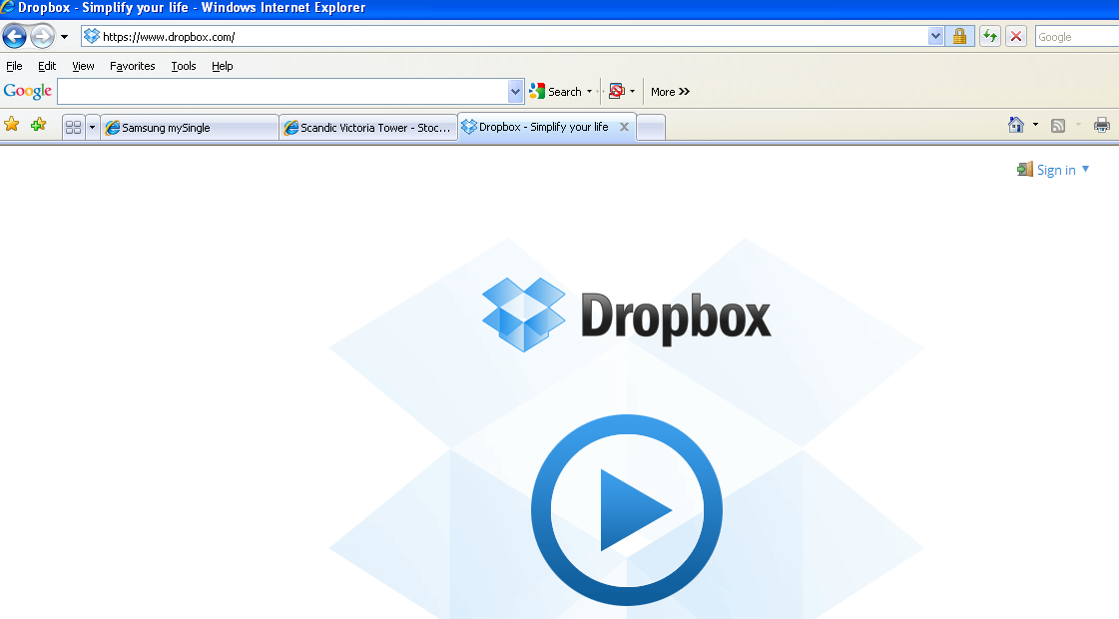
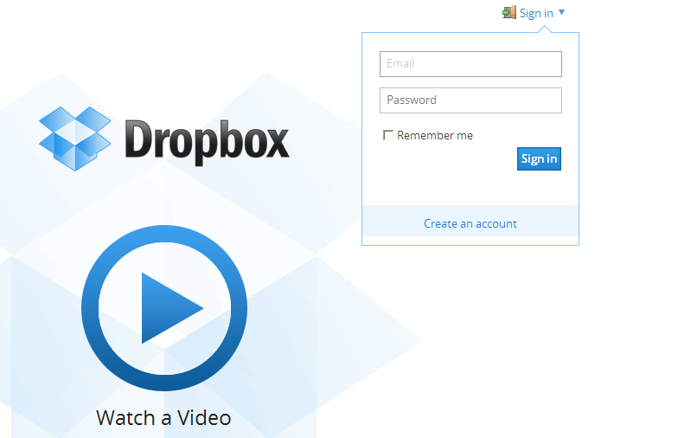
Dropbox – How to upgrade from 2GB to 50GB of space
1. On your PC please visit
http://www.dropbox.com
2. Sign in with the account details
used to create the account on your
GT-I9300 device

Slide 13
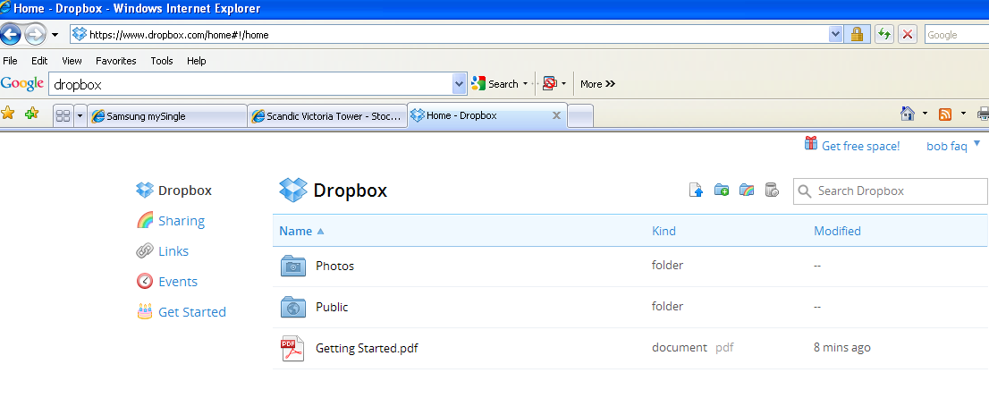
Dropbox – How to upgrade from 2GB to 50GB of space
3. Click on ““Get Started”

Slide 14
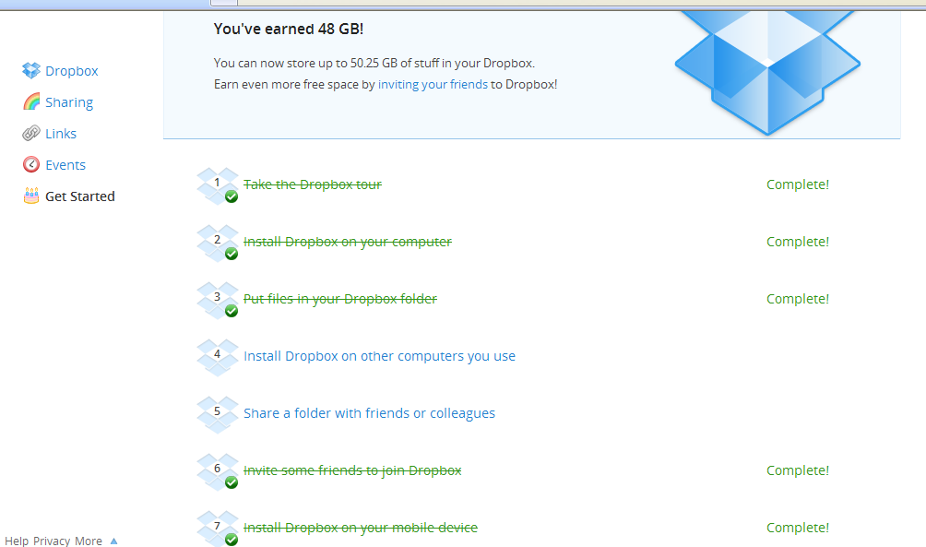
Dropbox – How to upgrade from 2GB to 50GB of space
4. Complete the required functions
Click on each link and follow the on screen instructions to :
Take the Dropbox tour
Install Dropbox on your Computer
Put files in your Dropbox folder
Invite some friends to join Dropbox
Install Dropbox on your Mobile device *
*(this should already be done as you have set
up an account on your GT-I9300 device already)

Slide 15
Dropbox – How to upgrade from 2GB to 50GB of space
After the required steps have been completed you will be advised that you have acquired additional space:

Slide 16
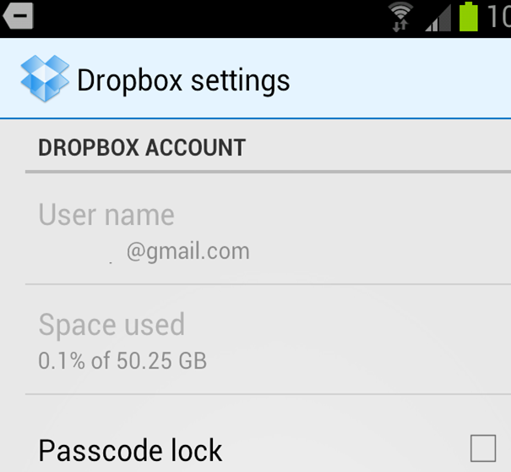
Dropbox – How to upgrade from 2GB to 50GB of space
Restart your GT-I9300 device.
If you recheck the settings of the Dropbox app on your device
you should see that the space has increased to 50 GB

Slide 17
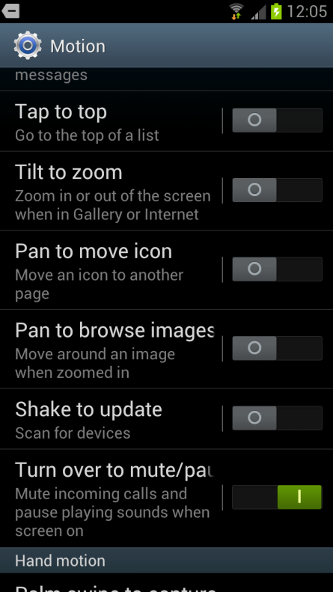
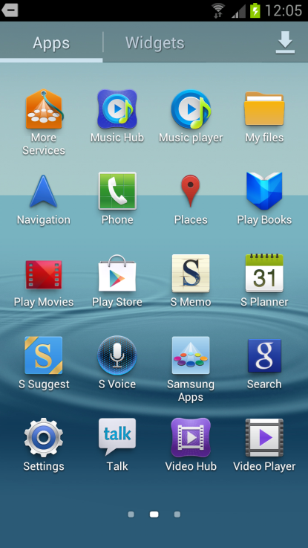
Motion – Turn Over with Music Player
Q: When playing a music file with the "Play music" application,
the "Turn Over" motion sensor is not working.
What should I do?
A: Your device is not faulty.
The "Turn Over" motion sensor function
works with specific applications which
are created by Samsung.
"Play music" is made by Google. So the motion function
is not compatible.
But "Music Player" application already which is
made by Samsung can use the "Turn Over" motion.

Slide 18
ChatON
Q: I can not upload a video file which downloaded from "ChatON" to Youtube.
What should I do?
A: Your device is not faulty.
A video file which has been downloaded from "ChatON" has a different internal format which is not
compatible with Youtube.

Slide 19
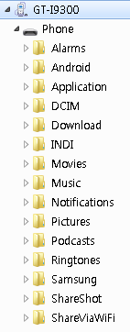
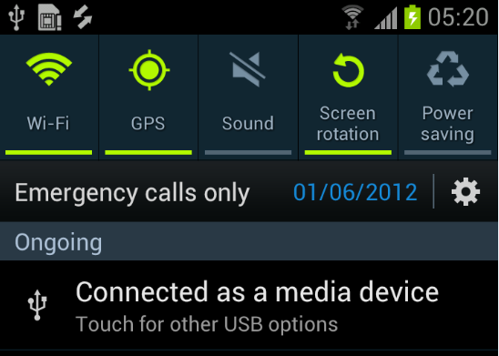
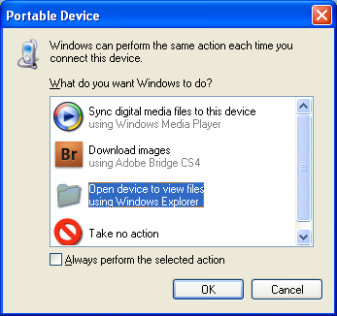
USB Connection (MTP Mode) (1/2)
Q: How do I use the MTP mode when connecting my mobile to PC?
A: Don’t need to set any menu, your mobile will automatically be recognized as an MTP device.
When connect your mobile to a PC with a USB cable, tap and hold on the status bar at the top of the
screen and “drag down”.
The below comment “Connected as a media device”
will be displayed
Your device has been recognized as an MTP device.
Status bar
Device memory as shown on the PC
Mobile
Pop up shown on PC when device connected via USB

Slide 20
USB Connection (MTP Mode) (2/2)
Q: What is the difference between MTP (Media Transfer protocol) mode and UMS (USB Mass
Storage) mode?
A: Both MTP and UMS mode have similar function to enable the transfer files between device and
PC.
But they have different features. Please refer to the below table.
MTP Mode | UMS Mode
ㆍCan transfer files (pictures, videos etc.) through this function. ㆍMore stable system than UMS. ㆍWhile in MTP mode, you can use other functions on the mobile device. ㆍSupports MSDRM. (Windows Media Digital Rights Management) ㆍNo limitation for file size to be transferred. ㆍService Pack 3 or greater required for Windows XP OS. | ㆍCan transfer files (pictures, videos etc.) through this function. ㆍWhile in UMS mode, you cannot use other functions on the mobile device. ㆍLimitation for file size that can be transferred – Only files up to 4GB in size can be transferred. ㆍCan play mp3 files through Car-kit.

Slide 21
AllShare Cast Function
Q: Where can I find "AllShare Cast" menu on my phone?
A: “AllShare Cast” is not currently supported on the GT-I9300 device at this time.
However it is expected that the “AllShare Cast" function will be supported from the
end of June 2012.
Samsung will release new firmware for your device with the AllShare Cast function
supported in due course.
(see next slide for advice on how to update SW via KIES)

Slide 22
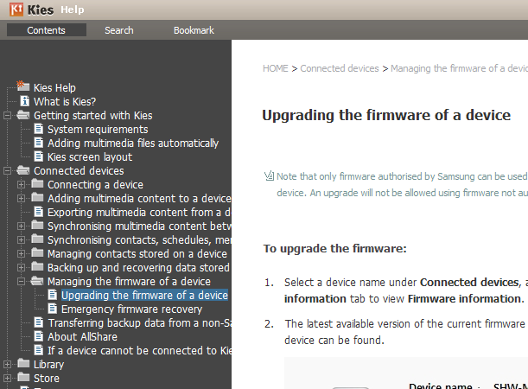
Instructions for KIES
Q) How to update my SW via KIES?
A) To find instructions on how to update your SW via Kies please download
and install the Kies SW tool from www.samsung.com.
Once the Kies SW is installed and running, Click on Help, then Kies help.
Then select
Connected Devices >
Managing the firmware of a device >
Upgrading the firmware of a device.
Instructions on how to upgrade
the firmware will be displayed.

Slide 23
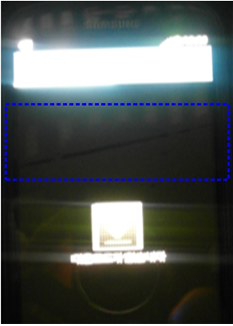
Display noise
Q: Sometimes an “Atypical” form or mark is displayed when the screen appears very dark or
black. Why does it happen and is my device faulty?
A: Your device is not faulty.
This phenomenon occurs due to the way in which the OCTA LCD display functions in an
abnormally dark environment (e.g. like a dark room)

Slide 24
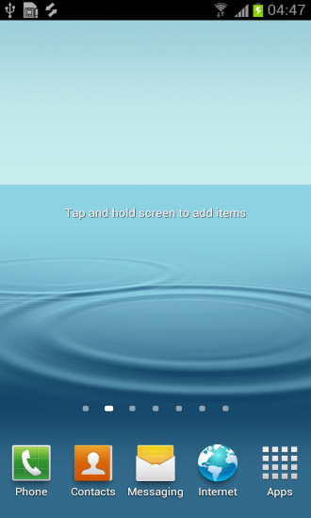
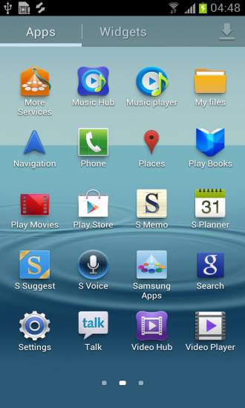
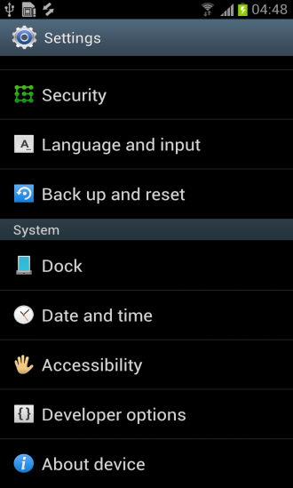
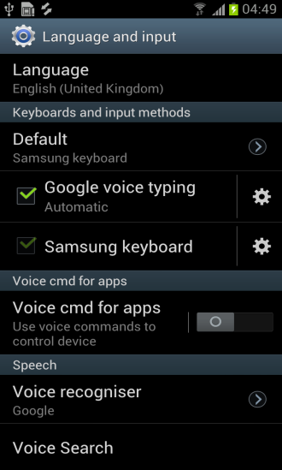
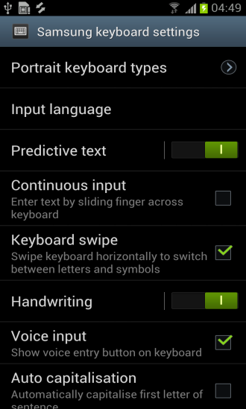
Swype (1/2)
Q: Can I use the "Swype" function in my GT-I9300, Galaxy S3 device?
A: Yes, you can use “Swype" function but the name used is different from previous models.
To access the “Swype” feature please see the steps below:
1. Tap on “Apps”
2. Tap on “Settings”
3. Select “Language and input”
4. Tap in the settings icon next to Samsung Keyboard
5. Select “Continuous Input” (See note below)
Note: The name used for the “Swype” feature will change depending for the Language setting selected.
example) if language setting is Korean select: 연속입력
if language setting is English select: Continuous input
if language setting is Deutsch select: T9 Trace.
3. Tap on
Language and Input
4. Tap on
Settings icon next to
Samsung Keyboard
5. Tap on
Box next to
Continuous Input to
select “Swype” mode
2. Tap on Settings
1. Tap on Apps
See next slide

Slide 25
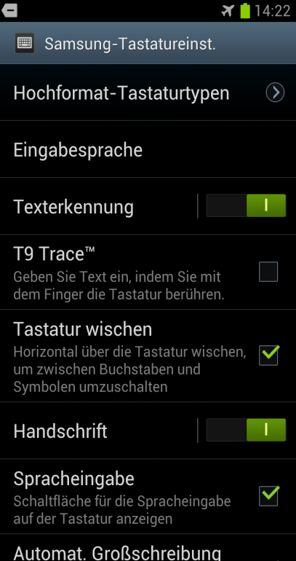
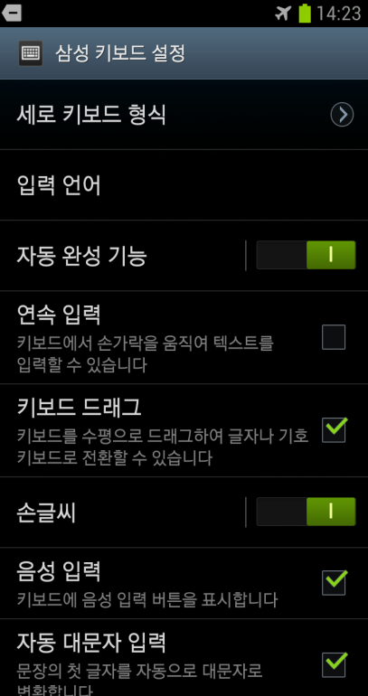
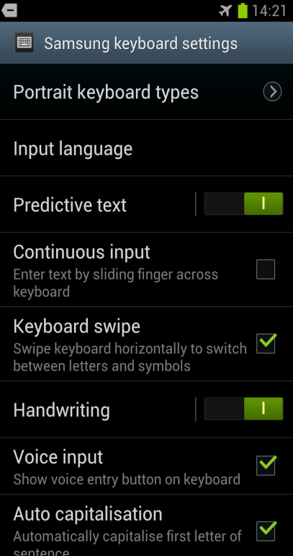
Swype (2/2)
Steps 4 and 5 from previous FAQ in details:
4. Tap in the settings icon next to Samsung Keyboard
5. Select “Continuous Input” (See note and pictures below)
Note: The name used for the “Swype” feature will change depending for the Language setting selected.
if language setting is Korean : 연속입력
if language setting is English : Continuous input
if language setting is Deutsch : T9 Trace.
if language setting
is Deutsch select
: T9 Trace.
if language setting
is Korean select :
연속입력
if language setting
is English select:
Continuous input

Slide 26
SMS Transfer (1/3)
Q: I want to transfer my SMS messages from my GT-I9100 (Galaxy S2) to my new GT-I9300 (Galaxy S3).
What should I do?
A: SMS transfer between a GT-I9100 device and GT-I9300 device is supported
by the "Export/Import" feature in Kies.
Please following slides for the steps to transfer your messages from a GT-I9100 device to a GT-I9300
device (using the Kies program running on a PC)

Slide 27
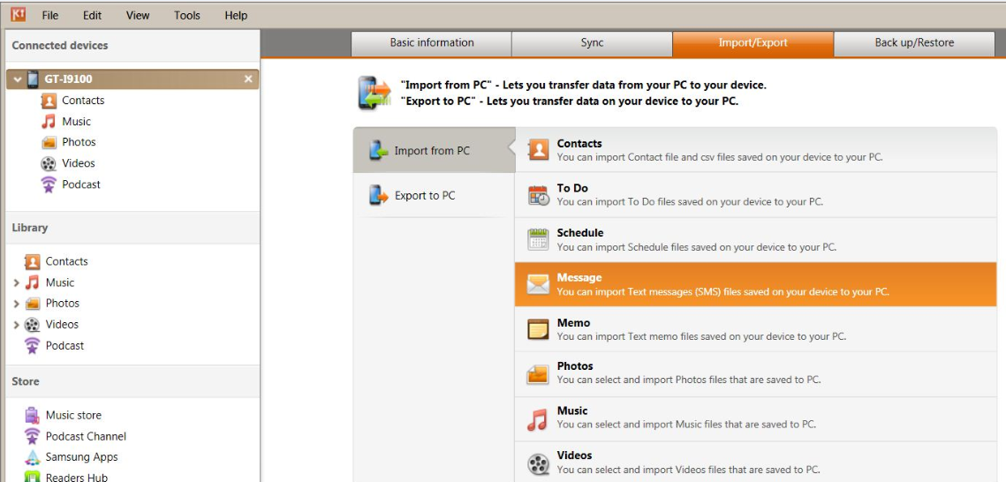
SMS Transfer (2/3)
1. Run the Kies program on your PC.
2. Connect the GT-I9100 handset to Kies via a USB cable.
3. Select "Export/Import" menu in Kies.
4. Select Message in "Export to PC" , then save those messages on your PC.
* The file extension is ".sme"
Exporting
messages
from
GT-I9100
3. Click on
Import / Export
2. GT-I9100 Connected
4.1. Click on
Export to PC
4.2. Click on
Message

Slide 28
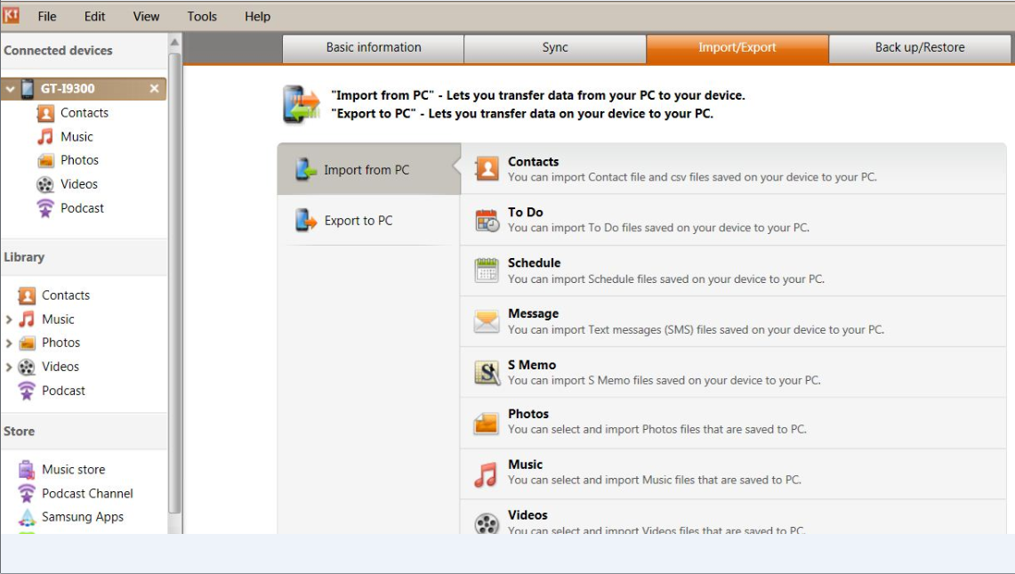
SMS Transfer (3/3)
5. Remove the GT-I9100 and then connect GT-I9300 to the PC running the Kies program.
6. Select "Export/Import" menu in Kies.
7. Select Message in Import from PC
8. The messages will be transferred to GT-I9300 from your PC.
Importing
messages
to
GT-I9300
6. Click on
Import / Export
5. GT-I9300 Connected
7.1. Click on
Import / Export
7.2. Click on
Message

Slide 29
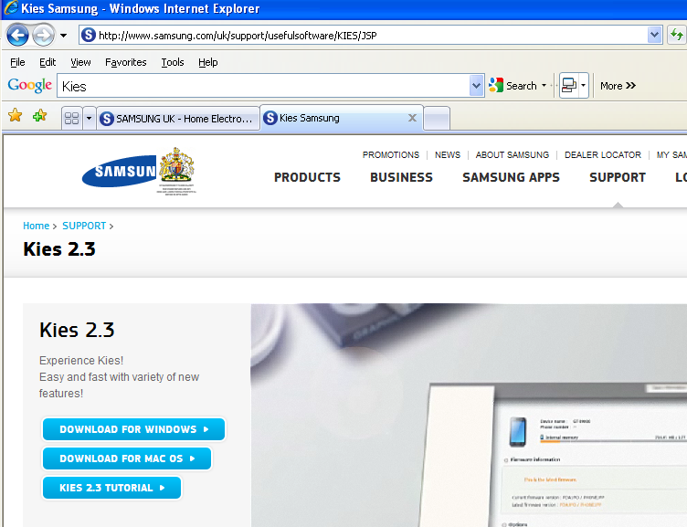
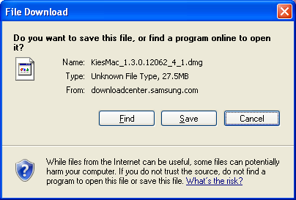
Kies for MAC OS
Q: Does Kies support MAC OS? Where can I download it?
A: Kies for Mac (Version 1.3.0.12062_4_1.dmg or above) can be downloaded and saved from
ww.samsung.com (Select “SUPPORT” menu)
Please see example link below for UK region:
http://www.samsung.com/uk/support/usefulsoftware/KIES/JSP

Slide 30
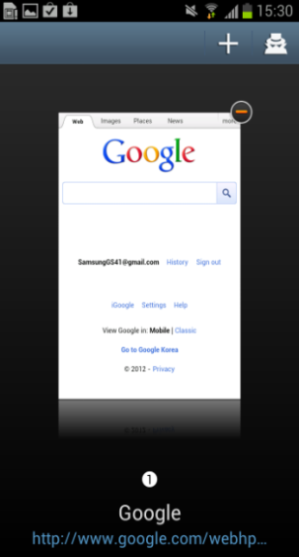
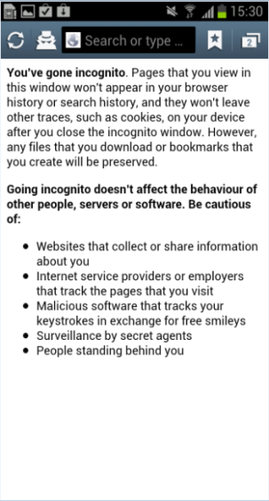
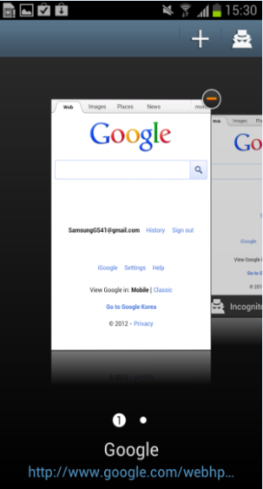
Incognito Pages
Q: What is an “Incognito” page in my web browser? What is it used for?
A: An “Incognito” page is one that won’t appear in the browser history
of your device or search history after closing page.
Please follow below steps to use this function.
1. Select thumbnails
of active browser
windows icon
2. Select
“Incognito
page Icon”
3. The incognito
page explanation
is displayed
Incognito page Icon
1.Select
2. Select
3. Select
Incognito page Icon
You can input web address
Ex. Google.com
If you want to use normal web page, not the incognito page,
just press thumbnails of an active browser windows icon,
Then you can select a web page not using “Incognito”.

Slide 31
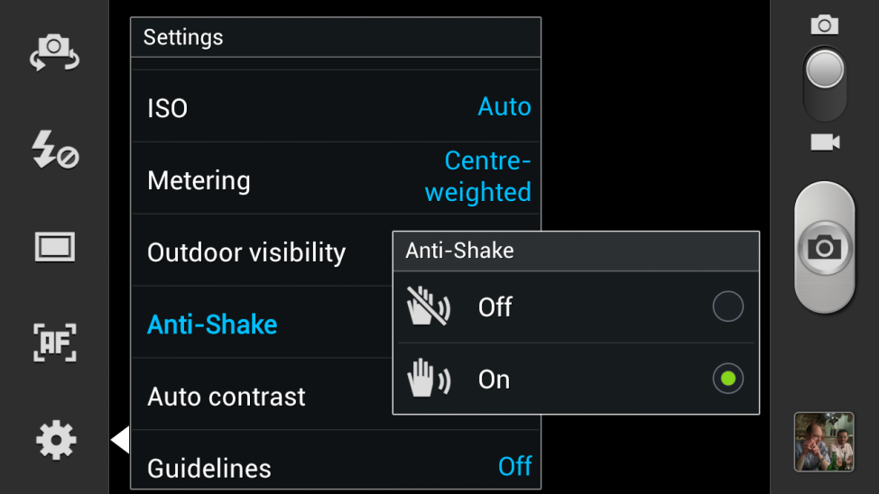
Capture Feature
Q: I cannot capture an image from a video I am recording.
Is my handset faulty?
A: Your device is not faulty. The capture feature
will not work when the “anti-shake” feature of the
is camera is activated
in the settings area.
Anti-Shake
Settings
The below comment box taken from
a copy of the user guide for the GT-I9300

Slide 32
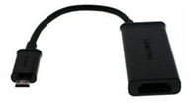
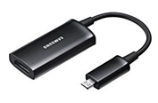
HDMI connector
Q: The HDMI cable for my GT-I9100, Galaxy S2 is not working with my GT-I9300, Galaxy S3.
What should I do?
A: The HDMI cable shown below for the Galaxy S2 is not compatible with Galaxy S3.
There is a separate HDMI cable for Galaxy S3.
The key difference is the number of pins in the connector.
* HDMI for Galaxy S2 has 5 pins.
* HDMI for Galaxy S3 has 11 pins.
HDMI for Galaxy S2
HDMI for Galaxy S3
(Part Number - EPL-3FHUBEGSTD)

Slide 33
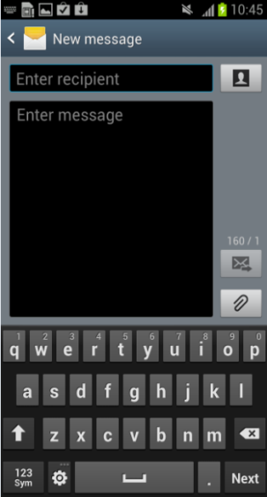
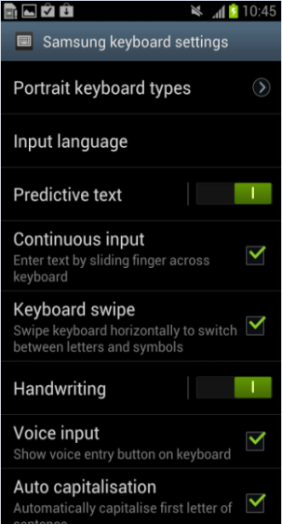
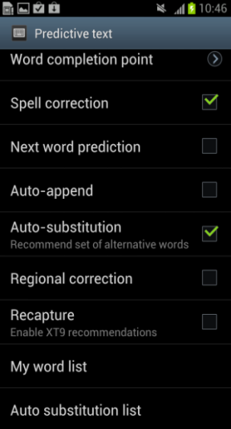
Predictive text
Q: There is no function for saving new words I have used when creating a message as “predictive
text “on my mobile. What should I do?
A: The mobile automatically saves new predictive text you have used.
You can find the words saved as predictive text in “My word list” menu.
Go to Setting – Predictive text – My word list
Example: “Made up" word Asdfghj
saved in My Word list

Slide 34
Multi Coating – Rainbow appearance
Q: Sometimes my white battery cover shines reflected light like a “Rainbow”.
What is problem and what should I do?
A: The GT-I9300, Galaxy S3 uses a pearl white glossy material coating on its surface.
The reason other colors appear is due the appearance of reflected light after refraction by the
coating on the cover.
The is no defect with your device.
Reflected light is “Refracted” - It looks like a “Rainbow”
Light
Refraction
Battery Cover

Slide 35
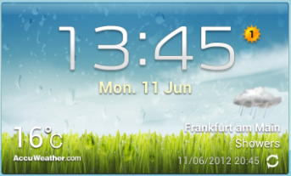
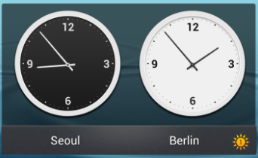
Daylight Saving Icon
Q: In weather widget, there is a strange icon that looks like the Sun. What is it?
A: It is the Daylight Saving Time Icon.
The area or locations that use Daylight saving time (Summer time), will be indicted by the icon
in the Weather Widget and Dual Clock widget.
Weather Widget
Dual Clock Widget

Slide 36
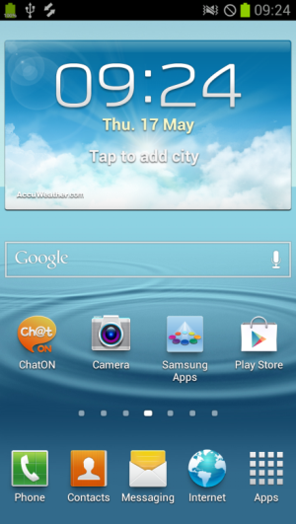
Call settings – How to access call settings option.
Q: How do I access the “Call settings” option
on my Galaxy S3, GT-I9300 device?
A: Please see the steps below to see how to
access the “Call settings” option for the Galaxy S3.
1. From the standby home screen, tap Phone.
2. Select the left menu (or Option) key.
3. Call settings option displayed.
Note: For reference, the method used
on some other models e.g.
Galaxy Note (GT-N7000) is as follows.
1. Tap Apps > then Settings > then Call settings
.

Slide 37
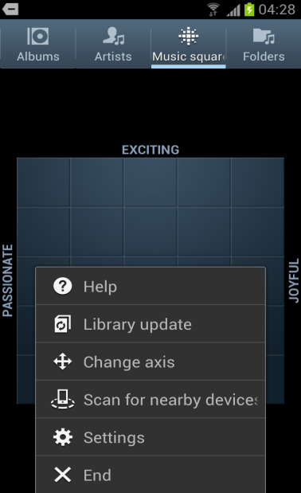
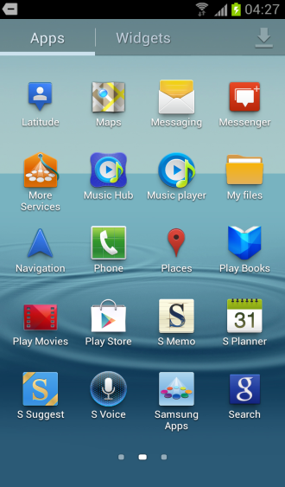
Music Player
Q: I put an micro SD card in my GS3 with some MP3 Music files stored on it and want to play
them using the “Music Player” app.
However, the songs that are stored on the SD card are not seen in “Music Square” tab of
the player, so it is not possible to play them back. What should I do?
A: Your device is not faulty.
You need to updated the Music Player Library after adding new music to the handset through
either download or micro SD card. Then you can play music normally.
1. From the standby home screen, tap Apps.
2. Tap
Music Player
3. Music Player
displayed
3-2.Select
Library Update
2.Select
1.Select
3-1.Select Option key

Slide 38
Notification setting off
Q: I set the “Notification” function via the quick menu panel to “Off”. But now a missed call is not
displayed in the indicator.
What is problem and what should I do?
A: Your device is not faulty. What you are experiencing is part of the GT-I9300, Galaxy S3 concept.
If Notification function is turned off , the missed call notification is turned off too.
To improve customer satisfaction, Samsung is working on an update to this feature.
When the Notification function is turned off, a “slanted line” icon will be shown to improve
visibility of the setting.
It is expected that this update will
be available a the next release of
SW for update via Kies.
Current display
Future display

Slide 39
Wrong display of Message Shortcut icon (1)
Q: I confirmed all the messages received in the “messaging” box.
But the message icon in home screen shows there is a
new message which has not been read.
What is problem and what should I do?
A: Normally, this problem does not occur.
However if you chose the Settings option “Do not keep activities”, this problem can occur.
“Do not keep activities” option is one of the “Developer options” settings.
To amend the settings Tap on 1. “Apps”, then 2. “Settings”, then 3. “Developer Options”,
then change the setting in 4. “Do not keep activities” to that shown here:
4
2
3
1

Slide 40
Wrong display of Message Shortcut icon (2)
It is option which became open for Android App developers to change the device settings for
application development purposes. It has an influence on basic applications of the handset
operating system, and when used, a malfunction may occur
Therefore, unless you are an Application developer, we do not recommend setting
“Do not keep activities”.
The below comment box taken from
a copy of the user guide for the GT-I9300

Slide 41
Picasa Sync Image
Q: I can not delete pictures which are synchronized from "Picasa " in the handsets “Gallery”
applications.
What should I do?
A: In the Google+ Application, you can delete the picture which has been synchronized from "Picasa "
but the Gallery application menu doesn’t support the "delete" option.
You can update Google + by downloading the application from Google “Play”
(Google “Play” is the new updated version of Android “Market”)
※ What is “Google+”?
Share and keep up with people no matter where you are with the Google+ app.
Join a hangout, post a photo, or see what friends are sharing while you’re on the go.
Use Messenger to get everyone on the same page with fast, simple group chat.

Slide 42
3*4 Keyboard usage
Q: When I input a new message with “3 x 4 “keyboard
, it is very difficult to input and revise
other words except a word registered beforehand
in “My Word List”.
Also, the revised word is not saved either.
What is problem and what should I do?
A : Because the “Predictive text” option is ON, text input may sometimes be awkward.
To correct this, set “Predictive text” option to OFF (see step 3).
Also, you can set the “Recapture” function (see step 4) on “Predictive text” menu to ‘ON’ , and
the revised word will be saved too (to “My Word List”) .
3.Select
(drag the bar to left to select “off”
4.Select
2.Select
1.Select

Slide 43
3*4 Keyboard usage
If “Recapture” option is ‘ON’ , the revised word from “My Word List” will also be saved to “My Word
List” – as shown in the example below.
The revised word “Pamptmgg” from “Samsunggreat” in ‘My word list’
2.Select
3.Select
1.Select
Note: to disable the Predictive text feature so text can be entered without
words being suggested, slide the Predictive text bar to the left so the
bar changes colour from Green to Grey.

Slide 44
Voice Message button
Q: I cannot find an icon to make a voice message in the message App.
What should I do?
A : The path to find the “voice message icon” is changed in the GT-I9300, Galaxy S3.
Press setting icon for 2~3 seconds to make a voice message.
Follow the steps below screen.
Voice message icon
- if not present see next box
GT-I9300
1. Press this setting icon for 2~3 seconds icon for ~3 seconds
2.Select the Microphone icon

Slide 45
SMART View App
Q: I want to use the “SMART View” App on my Galaxy S3, GT-I9300 that I already used on the
Galaxy S2, GT-I9100.
But I can’t find SMART View in ‘Play Store’.
What is problem and what should I do?
A : Sorry for your inconvenience.
Samsung is revising a resolution-related problem
of ‘SMART View’ App.
You will be able to access ‘SMART View’ in the near future.
Galaxy S2, GT-I9100. You can see ‘Samsung Smart View’ App

Slide 46
Home Key reaction speed
Q: The home Key reaction seems to be very slow.
Is my device faulty?
A : Your device is not faulty.
In the GT-I9300, Galaxy S3, the S-Voice function is
executed by pressing the home key twice (‘Home Key double-click’)
A certain amount of time is required for the handset to distinguish a
double-click or a “one-click” single click operation.
The Delay time you are experiencing
was added to ensure that the handset would allow time enough
for the customer to carry out a “double click”.
Double-click : ‘S-Voice’ App. Execution
One-click : Home screen return

Slide 47
TSP sensitivity (1/2)
Q: My Galaxy S3 is touched by a metal object, specifically my keys.
So although I don’t intend it to happen, my lock screen is unlocked by the key in my pocket.
What should I do?
A : Your device is not faulty.
Samsung improved the sensitivity of Galaxy S3 for ‘S-Memo’ App support with a Capacitive touch
or “C” pen.
However the threshold value used on your device to recognizes a “C” Pen with the display is
similar to that of a Key.
So Galaxy S3’s screen seems to recognize a key as if it were a ‘C Pen’ and react.

Slide 48
TSP sensitivity (2/2)
Note: reference to proximity to metal objects e.g. “Keys” is made reference to in the user guide
Samsung recommends the use of Pattern Lock or Password Lock function to minimize the risk of
malfunction by metal objects such as coins, keys and necklaces.

Slide 49
Home key malfunction
Q: The Home key on my Galaxy S3, GT-I9300 malfunctions.
The Home key works when I want to wake up the device, but the Home key doesn’t work when
idle screen is displayed.
What is problem and what should I do?
A : Please first back up data you wish to keep to PC e.g. via Kies.
If there are errors with the initial setup, performing a Factory reset can help to enable your device
to work normally. (see steps below)
6.Select
4.Select
1.Select
5.Select
2.Select
3.Select

Slide 50
Message ringtone on Notification setting off
Q: When I receive a new message, the message ringtone doesn’t sound and the
handset does not vibrate.
What is problem and what should I do?
A: Please check the status of the Notification feature in the quick menu panel to see if it is set to
‘OFF’ (Disable).
If set to “Off” the colour of the Notification Icon will be Grey
If the Notification feature is set to “Off”, the message ringtone will not sound and the handset
will not vibrate.
To be notified of incoming messages, set the Notification feature ‘ON’ (Enable).
Set the Noti. function to ‘ON’(Enable)

Slide 51
Message ringtone on Notification setting off
Q: How do I access the quick menu panel to see if the Notification feature set to
‘OFF’ (Disable).
A: Please see the steps below:
1. Tap and hold, then drag down the indicator bar
2. The quick menu bar will be displayed
3. Sweep across the screen with your finger until the Notification icon is shown
1. Tap and hold and , then drag
2. Quick menu panel shown
3.1. Notification icon
3.2. Notification Enabled

Slide 52
How to enable the “3*4” Keyboard
Q: How do I access the “3 x 4 “keyboard?
(I want to change from using the
Qwerty Keyboard)
A : To enable the “3 x 4” keyboard, please see the steps below:
1. Tap “Apps”
2. Tap “Settings”
3. Tap “Language and input”
4. Tap the Settings icon next to Samsung Keyboard
5. Tap “Portrait Keyboard” types
6. Tap “3 x 4 Keyboard”

Slide 53
S-Voice support language
Q: Why, when I try to use the S-Voice application, it doesn’t seem to support
the Russian, Chinese or Japanese languages.
Is my device faulty?
A: Your device is not faulty.
The S-Voice application currently supports English, French, , Italian, Spanish, Korean and
German languages.
Samsung is processing development other national languages including Russian, Chinese,
Japanese..
Note:
It is expected that software updates to introduce these additional languages will be available as follows:
Chinese: By end of July 2012
Japanese: By end of August 2012
Russian: By end of September 2012
,

Slide 54
Pop up play 1/5: What is it?
Q: What is this new feature, “Pop up play”?
A: “Pop up play” is a Picture-in-picture technology the lets you watch an HD video in another window
while sending an email or text simultaneously.
Drag it to where you want on the screen, and chat with your friends or surf the web.
Don't miss any of the action.

Slide 55
Pop up play 2/5 : How do I use it?
Q: How do I use the “Pop up play” feature?
A: Please see the steps below for advice on
using the “Pop up play” feature:
1. When you play back a video, tap on the screen
to display the Video screen controls
2. Tap on the “Picture in picture icon.

Slide 56
Pop up play 3/5 : How do I use it?
Q: How do I use the “Pop up play” feature? continued
3. The video being
played will now “pop up” on the Applications
screen
4. Tapping on the “pop up” image will revert the video being
played back to “full screen mode”

Slide 57
Pop up play 4/5 : How do I use it?
Q: How do I use the “Pop up play” feature? continued
5. You can touch, hold and drag the video being
played to a different part of the display

Slide 58
Pop up play 5/5 : How do I use it?
Q: How do I use the “Pop up play” feature?
6. To close the “pop up play” video,
touch an hold on the video being played.
The “-” symbol will appear.
Tap on the “-” symbol to close the video
7. When the “pop up play” video is being played, you can still
navigate around the device to do other actives
Note: when the video being played back has finished, the “pop up play” feature will close

Slide 59
Camera open fail
Q : When I ran Camera app of my Galaxy S3, GT-I9300 , it doesn’t sometimes work.
Is my device faulty?
A : S/W upgrade can re-solve the Camera issue.
Please upgrade Galaxy S3 to the latest S/W version.
If you still have a Camera open problem after S/W upgrade, please visit the Service center.

Slide 60
Volume during voice call(1/2)
Q : The Voice volume of my Galaxy S3, GT-I9300 shrinks more and more volumes during voice call.
What is problem and what should I do?
A : In noisy environments, you may have difficulty hearing some calls.
And when you leaves from a microphone of handset more and more distantly during voice call,
you can hear weak volume.
At first, please talk in microphone neighborhood in during the call.
When there is the issue of voice volume persistently in your Galaxy S3 , we recommends you
set the ‘Noise reduction off’ option.
Note: reference to “Noise reduction off” option is made reference to in the user guide

Slide 61
Volume during voice call(2/2)
Note: when you set the ‘Noise reduction off’ option, icon is displayed on call screen

Slide 62
Show pointer location of Developer options(1/2)
Q : When I touch the screen of my Galaxy S3, strange line is made and it doesn’t disappear.
What is problem and what should I do?
A : Normally, this problem does not occur.
However if you chose the Settings option
“Show pointer location” , this problem can occur.
“Show pointer location” option is one of the “Developer options” settings.
To amend the settings Tap on 1. “Apps”, then 2. “Settings”, then
3. “Developer Options”, then change the setting in
4. “Show pointer location” to that shown here:
2
3
1
4
62

Slide 63
Show pointer location of Developer options(1/2)
“Show pointer location” option traces of the pointer when you touch the screen.
It will look like a strange line by the real use.
It is option which became open for Android App developers to change the device settings for
application development purposes. It has an influence on basic applications of the handset
operating system, and when used, a malfunction may occur
Therefore, unless you are an Application developer, we do not recommend setting
“Show pointer location”.
The below comment box taken from
a copy of the user guide for the GT-I9300

