Slide 1
Standard FAQ: Bada 2.0
Customer Consultant Guide
Bada mobile technology platform
Version 2.0
Global CS
ECC HHP review
23rd February 2012
Language : English

Slide 2
Revision History: This version replaces all previous versions
Date | Version | Comments
2011.10.14 | V1.0 | Initial version established ※ Slide 20,23,70,86 - Bada 2.0 New functions.
2012.02.23 | V2.0 | ECC HHP review of V1.0 from CS team HQ for Local English and Grammar Slide 7 – Call Waiting, additional pictures added showing Call Waiting selected. Step 6 added. Slide 9 – Hide Caller id, additional picture and Step 6 added showing “Hide” selected Slide 12 – Language support, Question and answer simplified for clarity, Step 6 expanded Slide 14 – Format SD card, Picture Fig A and note added regarding “The creation of necessary multimedia directories compatible with the handset” Slide 15 – Memory Check, additional picture added showing areas of memory that can be checked for availability Slide 21 – Add folder – steps reworked, new pictures added Slide 22 & 23 added – for Add Folder process Slide 24 – Delete Folder – reworked in line with notes from slides 21 / 22 / 23 Slide 29 – Font types – note added that selecting More Fonts will open Samsung Apps Slide 40 – Table & Picture added showing FM radio functions and buttons Slide 45 – additional picture and text added for Mobile AP setting Slide 50 – note added on WI-FI MAC address slide on location of device name Slide 55 – Updated Mass storage mode for Android advice to Bada advice Slide 61 - Alternative process for Gmail application (Tap on Gmail icon) removed as unit is a Bada device. Picture added showing Sync schedule Slide 62 – E-mail Client sync setting - text regarding “Google accounts added on Account and sync are associated with not Email but Gmail (Google Mail) application now Removed – GT-S7250 is a Bada device Slide 67 - Other accounts - Steps for setting email accounts edited - To Set Up a POP or IMAP account , step 2 expanded Slide 72 – note added You cannot assign an image to a contact stored on the SIM Slide 73 – Picture and “Key” added for Contact shortcut menu feature Slide 76 – additional notes added to final step and additional picture added Slide 78 - Turn Off Message Alerts – step 4 expanded, additional picture added Slide 85 – Memory slide re-worked around Memory available feature

Slide 3
Revision History: This version replaces all previous versions
Date | Version | Comments
 |  | Slide 91 added with Text to speech settings listed Slide 100 – additional text and picture added regarding Motions settings Slide 106 added – showing how to obtain the Facebook app Slide 109 / 110 – Clear browser updated from what is saved on ANDROID device to what is saved on a Bada device

Slide 4
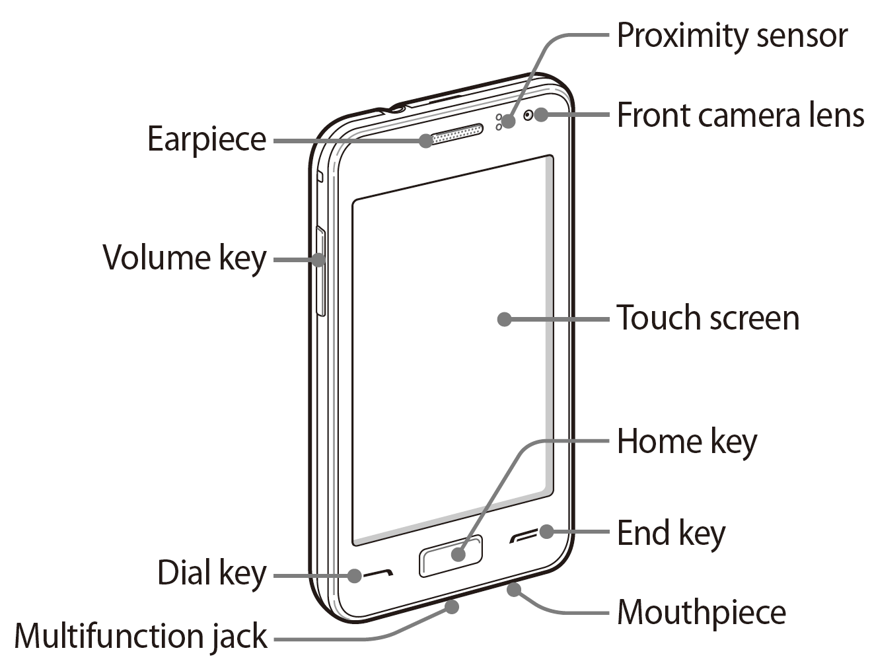
Use of OUTLINE feature of FAQ guide
In this FAQ guide, all slides have been titled so that slide name appears in the Outline Tab.
When using the guide open the Outline Tap and scroll up / down to help find the area you require
Screen shot above for example purposes only

Slide 5
Spec: Notice
Notice:
All functionality, features, specifications and other product information provided in this document including,
but not limited to, the benefits, design, pricing, components, performance, availability, and capabilities of
the product are subject to change without notice or obligation. Samsung reserves the right to make changes
to this document and the product described herein, at anytime, without obligation on Samsung to provide notification of such change.

Slide 6
FAQ Area 1
General Usage

Slide 7
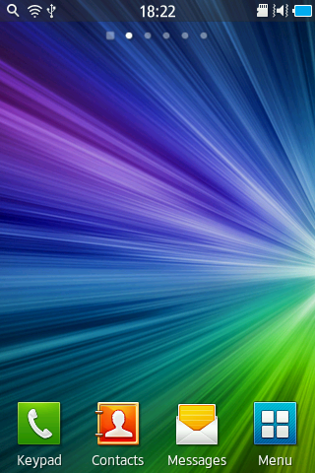
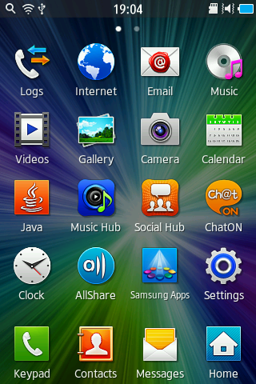
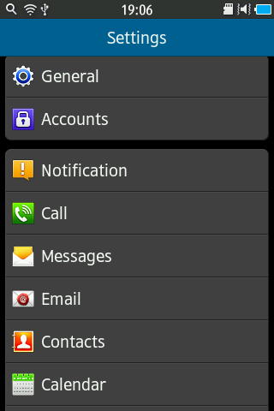
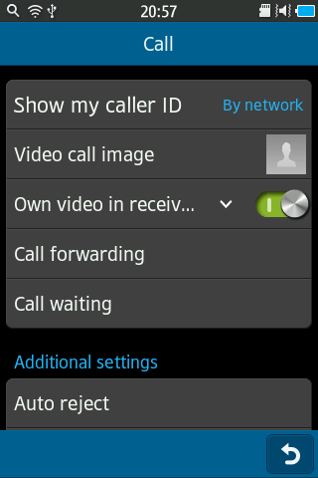
General: Call Waiting
Q : How do I activate Call waiting?
A : To activate Call Waiting follow the steps below:
1. From the standby screen, tap Menu.
2. Select Settings.
3. Scroll down to Call, and Select Call.
4. Select Call waiting.
5. Check Call waiting (Drag the grey circle to the right”).
6. Call waiting now set
5.Check
2.Select
4.Select
6.Call waiting now set
1.Select
3.Select

Slide 8
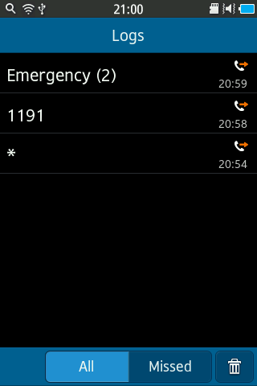
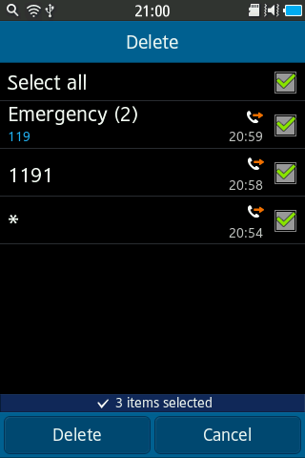
General: Clear Call Log
Q : How do I clear the Call Logs?
A : To clear the Call Logs follow the steps below:
1. From the standby screen, tap Menu.
2. Select Logs.
3. Select Delete icon.
4. Choose the desired Logs, then Select Delete.
2.Select
1.Select
4-1.Select
3.Select
4-2.Select

Slide 9
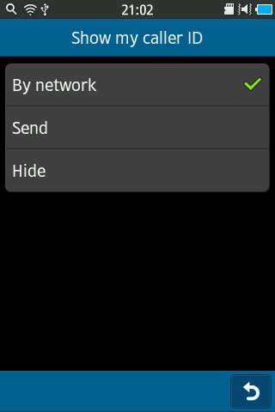
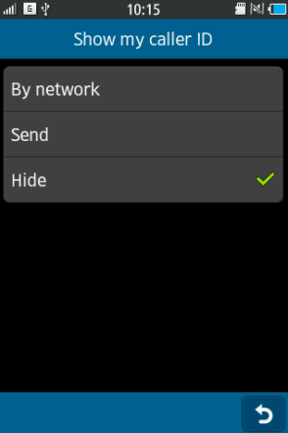
General: Hide Caller ID
Q : How do I hide my Caller ID from being displayed when calling someone?
A : To hide my Caller ID follow the steps below:
1. From the standby screen, tap Menu.
2. Select Settings.
3. Scroll down to Call, and Select Call
4. Select Show my caller ID.
5. Select Hide.
6. Hide selected
4.Select
2.Select
5.Select
6.Hide selected
1.Select
3.Select

Slide 10
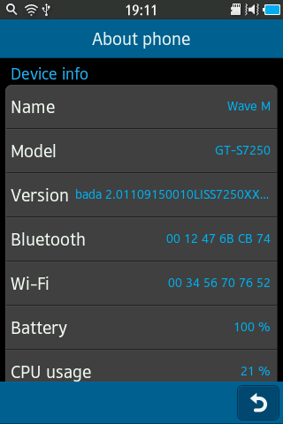
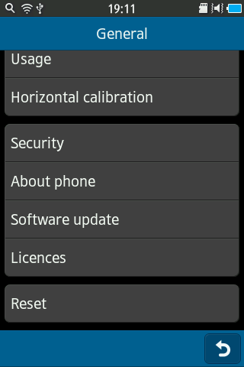
General: How do I Check handset software / Hardware information
Q : How do I check the Software / Hardware version on my phone?
A : To check the software/hardware version follow the steps below:
1. From the standby screen, tap Menu.
2. Select Settings.
3. Scroll down to General, and Select General.
4. Select About phone.
5. Select System info – Bada Version will be displayed:
3.Select
2.Select
1.Select
4.Select

Slide 11
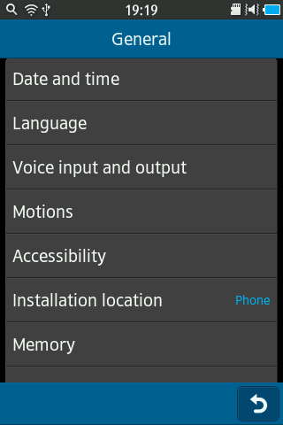
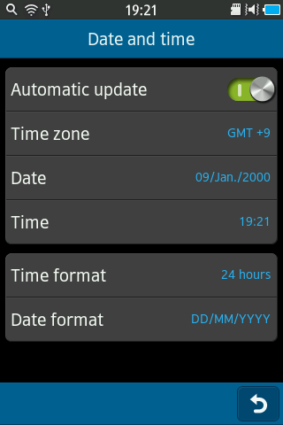
General: Time/Date - Daylight Saving Time
Q : How do I Enable or Disable Daylight Saving Time on my phone?
The handset uses NITZ (Network Initiated Time Zone) integrated into the phone's software and
will automatically update the time and date, if enabled.
A : To enable or disable the Automatic Network Time Update feature follow the steps below:
1. From the standby screen, tap Menu.
2. Select Settings.
3. Scroll down to General, and Select General.
4. Select Date and time.
5. Check Automatic update. (Drag the grey circle to the right”).
3.Select
4.Select
5.Check
2.Select
1.Select

Slide 12
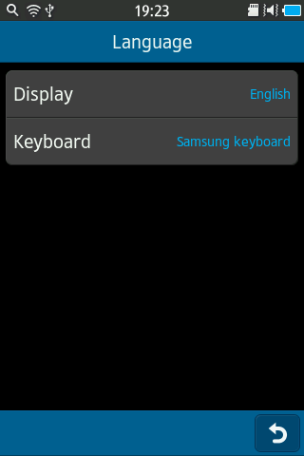
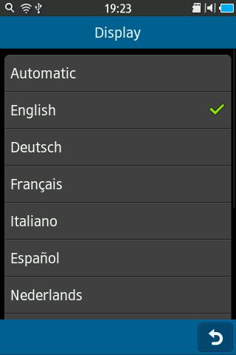
General: Changing Language Support
Q : Can I change the Default Language on the device with Default Settings?
A : To select a display language for all menus and applications initially installed on the device
1. From the standby screen, tap Menu.
2. Select Settings.
3. Scroll down to General, and Select General
4. Select Language.
5. Select Display.
6. Choose the locale / language you wish to use by tapping on it. Scroll up and down the screen to see all available languages.
6.Choose
3.Select
5.Select
2.Select
4.Select
1.Select

Slide 13
FAQ Area 2
Memory

Slide 14
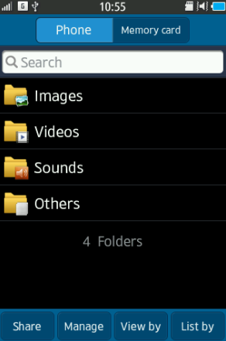
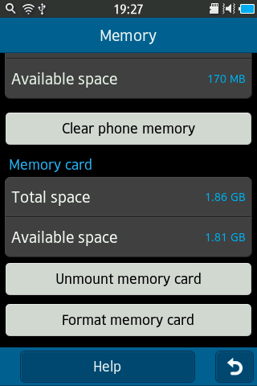
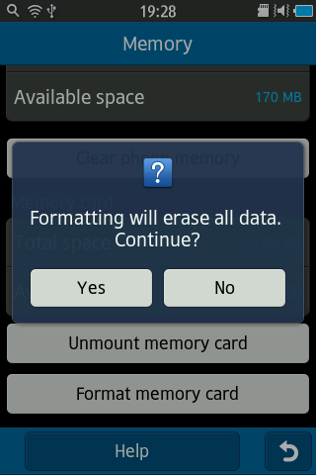
Memory: Format Storage Card
Q : How do I format the External SD card (Storage Card) on my phone?
A : To format an External SD Memory Card, using the handset, follow the steps below:
1. From the standby screen, tap Menu.
2. Select Settings.
3. Scroll down to General, and Select General
4. Select Memory.
5. Scroll down to “Format memory card”, and select Format memory card.
6. Select Yes.
Fig A: See note below
3.Select
2.Select
4.Select
5.Select
1.Select
6.Select
Note:
Formatting a micro SD Memory Card erases any data currently on the card and creates the necessary multimedia directories compatible with the handset. (See Fig A for picture showing Files set up after formatting)

Slide 15
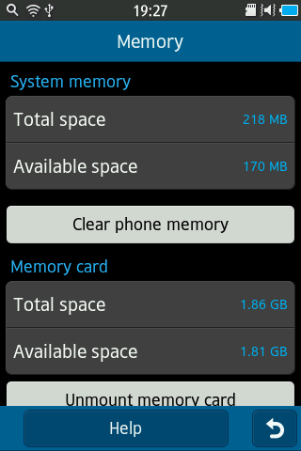
Memory: Check available memory
Q : How do I check the available memory?
A : To check the available memory follow the steps below:
1. From the standby screen, tap Menu.
2. Select Settings.
3. Scroll down to General, and Select General
4. Select Memory.
5. Available memory is displayed
3.Select
2.Select
4.Select
1.Select
5.Memory displayed

Slide 16
FAQ Area 3
Display & Camera

Slide 17
Display & Camera: Stylus will not work with the touch screen display
Q : When a stylus is used with the Touch Screen display of my device nothing happens. Why Is that?
A : The handset is designed to be used with fingers and not a stylus.
Most Samsung Smartphones come with a capacitive touch screen panel.
Interaction with the display disrupts the electrostatic field of the touch panel creating an input that the
sensor can recognize.
By utilizing normal styli, the field is not disrupted thus the display does not respond to touch input.
Due to the size of the display, one handed operation is improved with the greater surface area over
smaller displays.

Slide 18
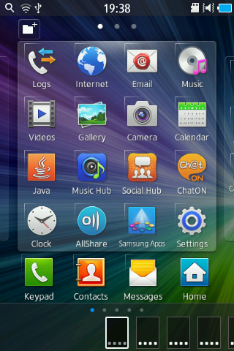
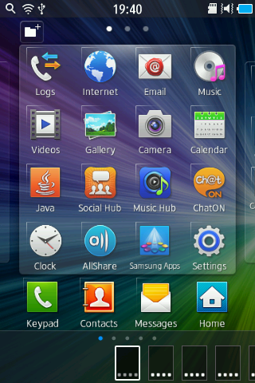
Display & Camera: Application Layout
Q : Can I customise how Applications are laid out (or Listed ) on my device?
A : To move applications around on the screen on my phone, follow the steps below:
1. From the standby screen, tap Menu.
2. Touch and hold desired icon.
3. All the applications will be highlighted by a line on the left and top side of icon.
4. Tap and hold on a application and drag it to move it to a desired location.
5. Select Back key.
1.Select
4.Change
2.Touch
& Hold
5.Select

Slide 19
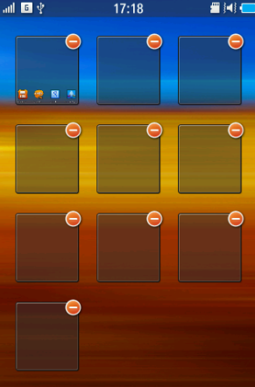
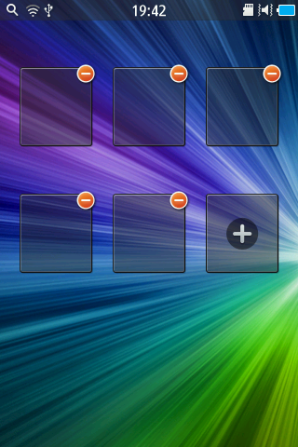
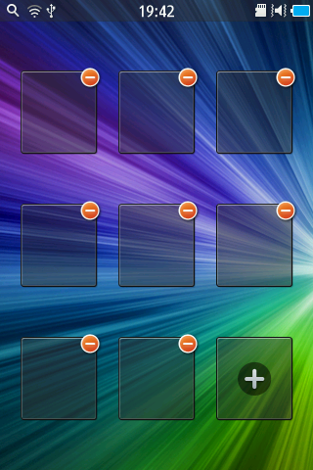
Display & Camera: Add New Panels to the Idle Screen
Q : How do I add New Panels to the Idle Screen?
A : To add new panels to the idle screen follow the steps below:
1. On the main Idle screen, Touch and hold two points on the screen at same time and pinch them together.
2. Select Plus(+) icon to add an extra panel.
Note to delete a panel tap on the “-” symbol in the top right corner of the panel
Icon.
Up to 10 panels can be running on the device
2.Select
Note:
To move the widget back to the widget toolbar, drag it to the widget toolbar.
You can see the number on Panels activated by counting the dots here!
As Widgets are added to the Idle screen, new panels are created to accommodate them.

Slide 20
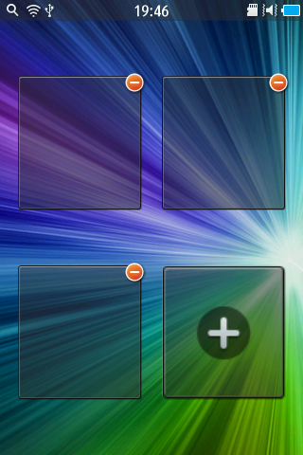
Display & Camera: Remove Panels to the Idle Screen
Q : How do I Remove panels from the idle screen?
A : To remove panels from the idle screen follow the steps below:
1. Touch two points at same time and pinch them together.
2. Touch Minus icon.
2.Select

Slide 21
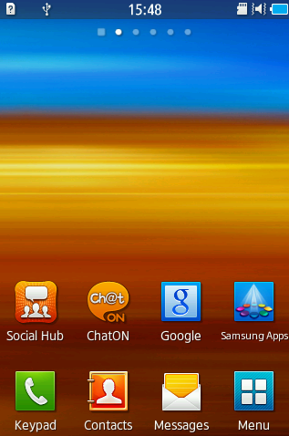
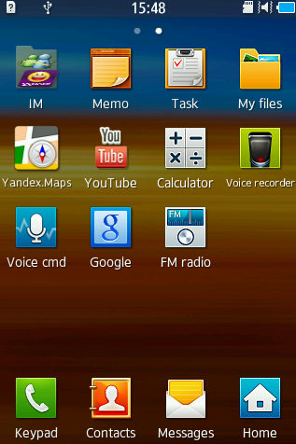
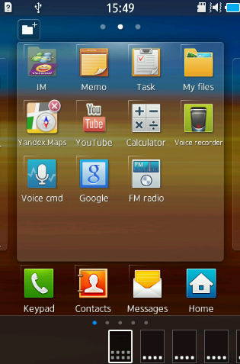
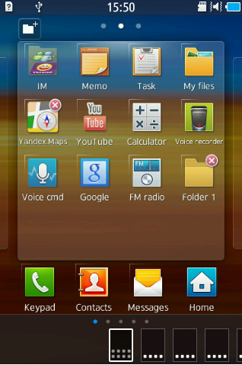
Display & Camera: Add a folder
Q : How do I add a folder on my phone?
A : To add a folder follow the steps below:
1. From the standby screen, tap Menu.
2. Touch and hold on the screen.
3. Select Add folder icon
4. Folder will be added
SEE NEXT SLIDE
3.Select
2.Touch
& Hold
1.Select

Slide 22
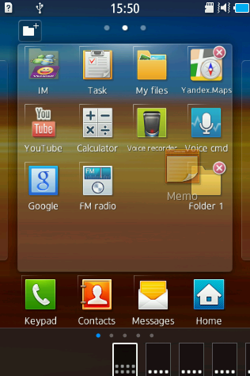
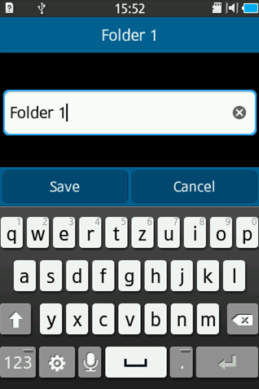
Display & Camera: Add a folder
Q : How do I add a folder on my phone?
A : To add a folder follow the steps below:
5. Touch and hold on an app you wish to add to a folder
6. Drag the app to the folder.
7. The app will now appear inside the folder
8. Tap on the Folder icon to open it
9. Tap in the area of the Folder name, and EDIT pop up box will appear where you can change the name.
Tap on Save to save the new name
10. Tap in this area to edit Folder name
5.Tap and hold
8.Tap
6.Drag
SEE NEXT SLIDE

Slide 23
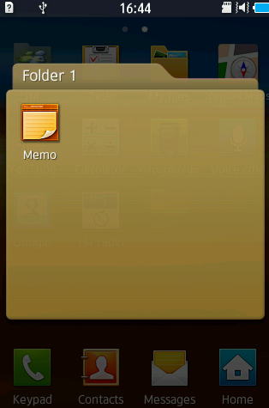
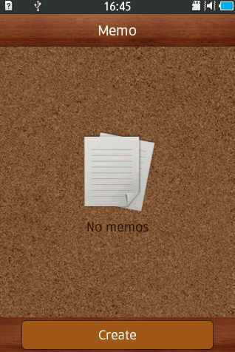
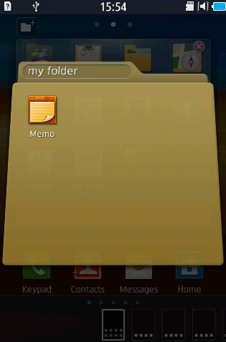
Display & Camera: Add a folder
Q : How do I add a folder on my phone?
A : To add a folder follow the steps below:
10. Once the folder has been renamed , press the back (End) Key.
11. If you wish to open the app in the folder, tap on its icon.
12. The app will open.
Use the Back key to return to the Applications Menu
Folder renamed
11.Select
10.Press
12.Application now open

Slide 24
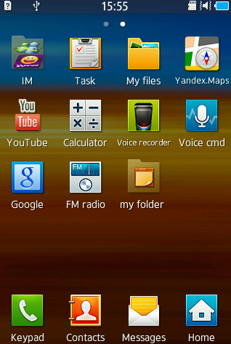
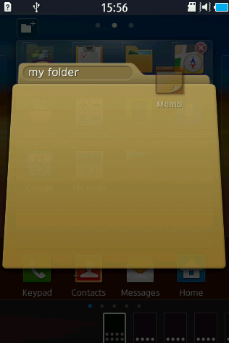
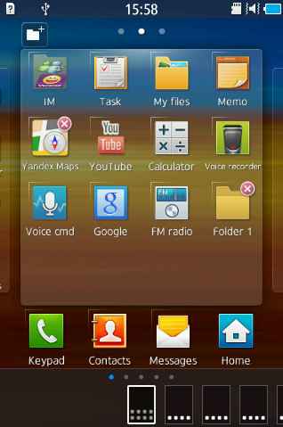
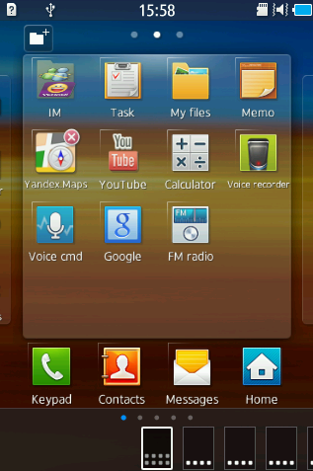
Display & Camera: Delete Folder
Q : How do I use the Delete Folder on my phone?
A : Delete folder follow the steps below:
1. From the standby screen, tap Menu and the tap on the folder you wish to delete
2. Tap and hold on the app stored in the folder
3. Drag the icon “out” of the folder area. Once the folder is empty the screen will change to the “Edit Menu” screen
4. Tap on the Delete icon of the folder. The app that was in the folder will now appear on the Application screen
5. Press the Back (End) key to exit the edit view
2. Tap and Hold and drag
3. Tap
1.Select

Slide 25
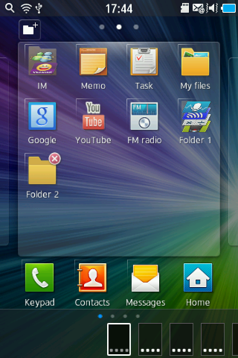
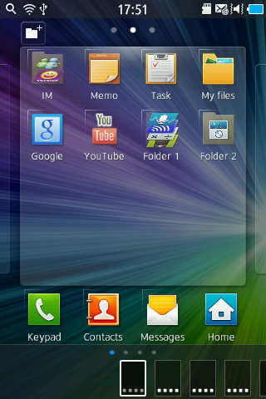
Display & Camera: Move icon
Q : How do I Move an app icon on my phone?
A : To move an app icon follow the steps below:
1. From the standby screen, tap Menu.
2. Touch and hold desired icon.
3. Drag desired icon to a preferred location
4. Select Back key.
2.Touch
& Hold
3.Drag
1.Select
4.Select

Slide 26
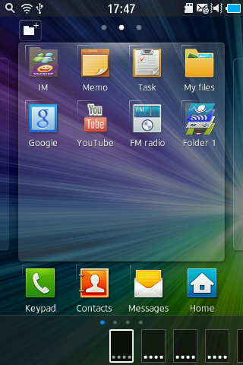
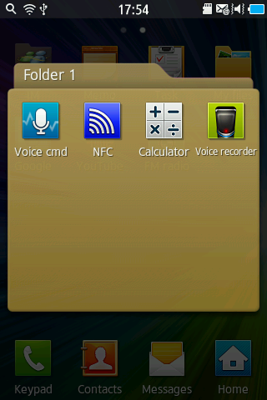
Display & Camera: Folder Preview (1/2)
Q : How do I use the Folder preview on my phone?
A : Folder Preview follow the steps below:
1. From the standby screen, tap Menu.
2. Select desired folder to see the apps moved there.
2.Select
1.Select

Slide 27
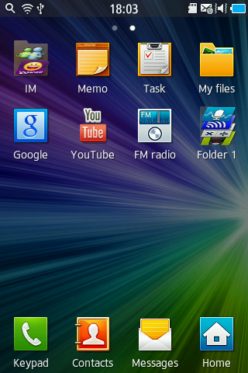
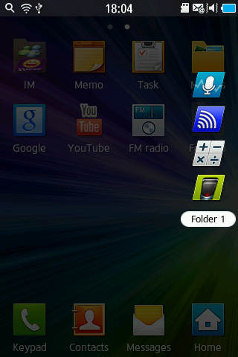
Display & Camera: Folder Preview (2/2)
Q : How do I use the Folder preview on my phone?
A : Folder Preview follow the steps below:
1. From the standby screen, tap Menu.
2. Touch and hold desired folder.
3. Drag desired folder – the contents will be shown as a list on icons
3.Drag
2.Touch
& Hold
1.Select

Slide 28
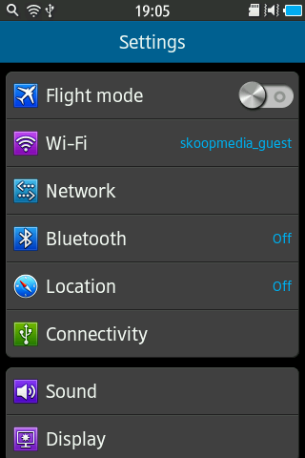
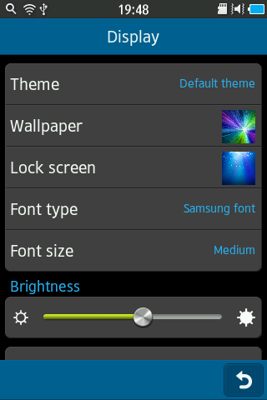
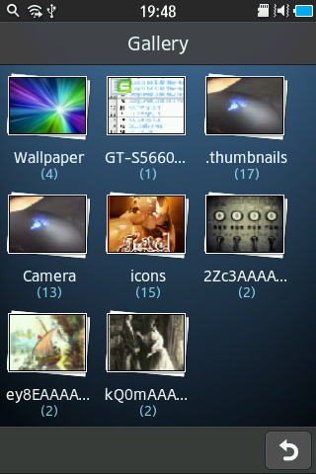
Display & Camera: Change Wallpaper
Q : How do I change the Wallpaper (screen saver) on my phone?
A : To change the default wallpaper follow the steps below:
1. From the standby screen, tap Menu.
2. Select Settings.
3. Select Display.
4. Select Wallpaper. (tap on Wallpaper or camera if more than one set of images is available)
5. Choose the desired wallpaper.
6. Select Set.
2.Select
4.Select
1.Select
3.Select
6.Select
5.Choose

Slide 29
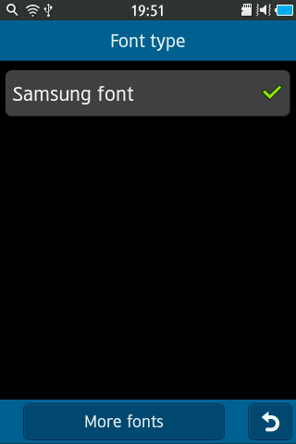
Display & Camera: Change Font
Q : Can I change the Dialing Font style on my phone?
A : No, there are no configurable options available to change just the dialing font size alone on the handset.
However, to change the menu font type which will also change the Dialing font follow the steps below:
1. From the standby screen, tap Menu.
2. Select Settings.
3. Select Display.
4. Select Font type.
5. Choose the desired font type. (Only one shown here available – “Samsung Font” –
More Fonts may be available by tapping on more fonts where you will be automatically be redirected to Samsung Apps. Note – SIM card must be inserted for Samsung Apps to function.
There may be a fee for Fonts Subject to availability)
5.Choose
2.Select
1.Select
3.Select
4.Select

Slide 30
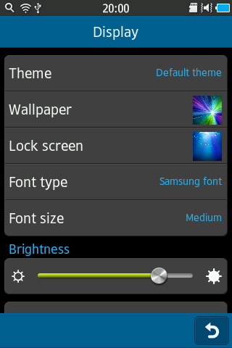
Display & Camera: Configure Backlight brightness
Q : How do I adjust the Contrast or Brightness on my phone?
A : Although there are no configurable options available to change the contrast on the handset display,
the display brightness can be changed.
To adjust the brightness follow the steps below:
1. From the standby screen, tap Menu.
2. Select Settings.
3. Select Display.
4. Adjust Brightness by touching brightness icon, to adjust move the bar from side to side.
5. Select Back.
2.Select
4.Adjust
1.Select
3.Select
5.Select
Note:
increasing the Brightness setting will increase battery power consumption

Slide 31
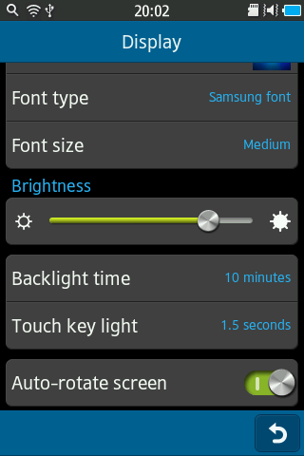
Display & Camera: Configure Backlight time
Q : How do I configure the backlight on my phone to stay on longer?
A : To configure the backlight on my phone to stay on longer follow the steps below:
1. From the standby screen, tap Menu.
2. Select Settings.
3. Select Display.
4. Scroll down the screen & Select Backlight time.
5. Choose desired screen timeout.
Highlight the time length, by checking from the following options:
▪ 15 seconds ▪ 30 seconds ▪ 1 minute ▪ 3 minutes ▪ 10 minutes
2.Select
1.Select
3.Select
4.Select
5.Choose
Note:
Increasing the display backlight time will reduce battery standby time.

Slide 32
Display & Camera: Thumbnail View
Q : Is there a Thumbnail View mode on my Home or Menu Screen?
Can I see all Icons in Home or Menu Screen at same time?
A : Yes . If you want to Thumbnail view of home screen, please touch two points at same time and “pinch” them
together.
Press the Back (End) key to return to normal view
-Home Screen-
-Menu Screen-
Thumbnail :
Thumbnails are reduced-size versions of pictures, used to help in recognizing and organizing them,
serving the same role for images as a normal text index does for words .

Slide 33
Display & Camera: Camera Files Storage
Q : Where are the Pictures and Videos that I have taken saved, by default , on the device?
A : The phone by default will store pictures and videos to the onboard memory.
Media captured / recorded can be found following the steps below :
1. From the standby screen, tap Menu.
2. Select My Files.
3. Select Images.
4. Select Camera.
2.Select
3.Select
4.Select
1.Select

Slide 34
Display & Camera: Keyboard Text entry method setting (1/2)
Q : How do I change Text Input Mode on my device?
A : To change text input modes follow the steps below:
1. From the standby screen, tap Menu.
2. Select Settings.
3. Scroll down to General, and Select General
4. Select Language.
5. Select Keyboard.
6. Select Other.
4.Select
5.Select
3.Select
6.Select
2.Select
1.Select

Slide 35
Display & Camera: Keyboard Text entry method setting (2/2)
Q : How do I change Text Input Mode on my device?
A : To change text input modes follow the steps below:
7. Select Keyboard type.
8. Choose the desired type.
7.Select
8.Choose

Slide 36
FAQ Area 4
Network & Radio

Slide 37
Network & Radio: Setting Roaming Option
Q : How do I configure the Data Roaming Settings on my device?
A : To configure the Data Roaming Settings follow the steps below:
1. From the standby screen, tap Menu.
2. Select Settings.
3. Select Network.
4. Check Data roaming – drag icon to the Right to enable.
2.Select
4.Check
3.Select
1.Select
Note:
To prevent data roaming when using the device abroad, ensure the Data Roaming box is “unticked.”

Slide 38
Network & Radio: Setting Flight Mode (Airplane Mode)
Q : How do I access Flight Mode on my device?
A : To access Flight Mode follow the steps below:
1. From the standby screen, tap Menu.
2. Select Settings.
3. Check Flight Mode.
Flight mode
3.Select
2.Select
1.Select

Slide 39
Network & Radio: Disable Packet Data settings
Q : How do I Disable GPRS / Data Packet, I Want to use Wi-Fi?
A : To Disable GPRS / Data Packet follow
the steps below:
1. From the standby screen, tap Menu.
2. Select Settings.
3. Select Network.
4. Check the Use packet data.
5. Untick box to stop data being accessed over Mobile Network.
Note:
To prevent data roaming when using the device abroad, ensure the Data Roaming box is unticked.

Slide 40
Network & Radio: FM Radio Frequencies
Q : How do I use the Auto Search function for FM Radio Frequencies?
A : To use the Auto Search function for FM Radio Frequencies follow the Steps below:
1. From the standby screen, tap Menu.
2. Select FM Radio.
3. Select Search.
See table to the right for more information about the FM Radio feature
1 | Scans and saves available stations.
2 | Open the available radio stations list.
3 | Change the frequency by scrolling left or
 | right on the scale bar.
4 | Turn off the FM radio; Select > to turn on
 | the FM radio.
5 | Search for an available radio station.
6 | Fine-tune the frequency.
7 | Add the current radio station to the
 | favourites list.
8 | Change the sound output (headset or
 | device’s speaker).
9 | Customise the FM radio settings.
10 | Record a song from the FM radio.
11 | Adjust the volume.
3.Select
2.Select
1.Select
Note:
FM radio feature requires headphones inserted to function.

Slide 41
FAQ Area 5
Connectivity

Slide 42
Connectivity: Transfer files from External SD card to device (1/2)
Q : How do I transfer MP3 Files from an external Micro SD card to my device?
A : To transfer MP3 files From a memory card to the handset memory follow the steps below:
Insert the micro SD memory card into the memory card slot
1. From the standby screen, tap Menu.
2. Select My Files.
4. Select the desired folder where file is stored on the external micro SD CARD.
5. Select Manage > Copy > Select file > Copy
6. Choose the desired File for copied file to be saved in
8. Select Paste.
See next slide
Warning:
Do not remove a micro SD memory card from the handset or turn off the handset while data is being accessed or transferred.
This could result In loss of data and/or damage to the memory card or to the handset.
Caution:
The plug-in micro SD memory card and its contents can be easily damaged by scratches or bending.
use caution when inserting or removing the card and keep all memory cards out of reach of children.

Slide 43
Connectivity: Transfer files from External SD card to device (2/2)
Q : How do I transfer MP3 Files from an external Micro SD card to my device?
A : Continued from Previous slide:
4.Choose
3.Select
2.Select
6.Select
1.Select
5.Select
7.Check
8.Select

Slide 44
Connectivity: Configure USB Settings
To connect via KIES:
1. Using a PC data cable, connect the multifunction jack
on your device to a PC.
Samsung Kies will launch automatically.
If Samsung Kies does not automatically launch,
double-click the Samsung Kies icon on your PC.
2 Copy files from the PC to the phone.
Refer to the Samsung Kies help for more information.
Note: to enable device to connect with Kies SW, ensure USB
debugging mode Is “un-ticked” (Applications>Settings>Applications>Development> USB debugging)
Q : How do I configure (or set) the USB connection on my phone?
A : To configure the handset's USB setting follow the steps below:
1. From the standby screen, tap Menu.
2. Select Settings.
3. Select Connectivity.
4. Select USB utilities.
5. Choose between Mass storage / Tethering or USB debugging
Note – Mass storage mode will switch between Mass Storage Mode or KIES
If selected when connected to a PC via a USB cable
4.Select
2.Select
1.Select
4.Select
3.Select

Slide 45
Connectivity: Mobile AP
Q : How do I set my device as a Mobile AP (Access Point)?
A : To set your device as a Mobile Access Point see the steps below:
1. From the standby screen, tap Menu.
2. Select Settings.
3. Select Connectivity.
4. Select Mobile AP.
5. Check the Mobile AP.
Scroll down the screen to see the name given to your device, and the KEY given to enable you to access your device
Via Wi-Fi from a PC to use the mobile device data connection.
(see slide / FAQ regarding MAC address to see how to locate your device name)
4.Select
5.Check
2.Select
1.Select
3.Select
Note: Advice above shows how to set your device as a wireless access point for PCs or other devices, and share your device’s mobile network connection.

Slide 46
Connectivity: AllShare (DLNA)
Q : How do I activate All share (for DLNA) for sharing media files?
A : To allow other DLNA-enabled devices to access media files on your device, you must activate media sharing follow the steps below :
Note: You must first activate the Wi-Fi feature and add a Wi-Fi profile to the device you want share with / through.
1. From the standby screen, tap Menu.
2. Select Allshare.
2.Select
1.Select
Important :
The Digital Living Network Alliance (DLNA) service enables you to share media files between DLNA-enabled devices in your home over a Wi-Fi connection.

Slide 47
Connectivity: AllShare (DLNA) Play files of one device on another device
Q : How do I Play files of one device on the other device?
A : To Play files of one device on the other device, follow the steps below :
1. From the standby screen, tap Menu.
2. Select Allshare.
3. Choose the desired media.
4. Select Menu key.
5. Select Upload.
6. Choose the desired media.
6.Choose
8.Select
2.Select
3.Choose
1.Select
5.Select
See next slide

Slide 48
Connectivity: Turn Wi-Fi On/Off (1/2)
Q : How do I turn Wi-Fi On or Off on my device?
A : To turn Wi-Fi on or off follow the steps below:
1. From the standby screen, tap Menu.
2. Select Settings.
3. Select Wi-Fi.
5. Select Activation.
6. Choose the desired Wi-Fi network to activate (connect to).
6.Choose
5.Select
2.Select
3.Select
1.Select
See next slide

Slide 49
Connectivity: Turn Wi-Fi On/Off (2/2)
Q : How do I turn Wi-Fi On or Off on my device?
A : To turn Wi-Fi on or off follow the steps below:
7. Enter Password if requested, then Select Connect.
Wi-Fi
7.Enter
Note:
When Wi-Fi is connected the Wi-Fi icon will appear at the top center of the display.

Slide 50
Connectivity: Wi-Fi - MAC Address
Q : How do I find the Wi-Fi MAC address on my device?
A : To find Wi-Fi MAC address follow the steps below:
1. From the standby screen, tap Menu.
2. Select Settings.
3. Select General.
4. Select About phone.
5. Scroll down to Wi-Fi.
MAC address will be listed here.
Note: Device name listed on this screen too
3.Select
2.Select
1.Select
4.Select

Slide 51
Connectivity: Wi-Fi - WPS Wireless Security connection
Q : How do I connect to a Wi-Fi using a Wi-Fi Protected Setup on my device?
A : To connect to a Wi-Fi with a WPS button, follow the steps below:
1. From the standby screen, tap Menu.
2. Select Settings.
3. Select Wi-Fi.
4. Select WPS button.
5. Press the WPS button on the access point within 2 minutes.
2.Select
3.Select
1.Select
4.Select
Note :
Using WPS, you can connect to a secured network.

Slide 52
Connectivity: Wi-Fi - Cannot Connect (1/2)
Q : When I try to connect my device to a Wireless Network, nothing happens. What can I do?
A : When connecting to a wireless access point, there are many variables to take into consideration.
Identifying the type of network offering being connected to determines how to best approach connectivity. Access
points can be broken down into three general categories, listed below.
Open Public Wireless Access Point:
These access points are generally found in places such as airports, coffee shops, or restaurants.
They do not require a password for connection.
Closed Public Wireless Access Point
These access points are generally found in places such as airports, coffee shops, or restaurants.
Such access points are either pay per use or a subscription based service.
They do require a password for connections or special client side software.
Closed Private Wireless Access Point:
These access points can be found in most home or businesses.
They require password for connections.
After choosing which is the best offering for the situation you are in, look to the sections on next slide for helpful information.

Slide 53
Connectivity: Wi-Fi - Cannot Connect (2/2)
Q : When I try to connect my device to a Wireless Network, nothing happens. What can I do?
A : Troubleshooting Wi-Fi Connections
Open Public Networks-
Move to a location with a better Wi-Fi signal strength if connection is weak and/or dropping
Power down the handset and power back on again
Turn the Wi-Fi radio off/on
Delete the SSID
Closed Public Networks-
Moved to a location with a better Wi-Fi signal strength if connection is weak and/or dropping
Power down the handset and power back on again
Turn the Wi-Fi radio off/on
Ensure proper credentials are entered as required
Some APs redirect to a portal to enter information before access is granted. Occasionally on mobile
devices, this page is not viewable. Try accessing the AP from a PC and enter in the information
If attempts are unsuccessful, please contact the wireless access point owner for additional assistance
Closed Private Networks-
Move to a location with a better Wi-Fi signal strength if connection is weak and/or dropping
Verify internet connectivity by using a computer to rule out WLAN problems
Power down the handset and power back on again
Turn the Wi-Fi radio off/on

Slide 54
Connectivity: Using Apple Mac computer with device Mass Storage mode
Q : How do I connect my device to my Mac book to use Mass Storage mode?
A : The phone can support a mass storage connection to a Mac.
In order to perform this task so that files can be transported from the Mac to the phone and vice versa, follow the steps below.
1. Plug the micro USB cable directly into the Mac.
2. Plug the other end of the cable into the phone.
3. Select Mass Storage when prompted.
4. Select Mount.
5. Depending on the amount of volumes, one or two drives will appear on the right.
Click on one to explore the file structure. When a folder or file is found that you desire to transfer, simply drag and drop it to the desktop.
6. When finished, don't forget to eject the volume by dragging it towards the Trash.
Note :
With USB debugging enabled, a window will pop up asking what to do with the connection.
Click cancel and close the window out. It has no bearing on file transferring.
- The FAQ is based on OSX 10.6.7
- In System Profiler, the volume should show up under the Samsung Android.

Slide 55
Connectivity: Using Mass storage mode
Q : How do I use Mass Storage Mode to transfer Data from my device to a PC?
A : To Connect in Mass Storage mode follow the sample steps below:
1. Go to Applications / Settings Connectivity / USB utilities / - ensure Mass Storage displayed.
2. Connect USB cable to device then Plug the other end of the cable in a USB port.
• Tip : Avoid the use of multiport hubs of possible.
3 . The PC will throw an option window. Click on Open folder to view files.
4 . Navigate to the desired files to be transferred and either drag and drop them over or copy and paste them into the directories.
• Technical Support (Windows 7)
There will be two sets of drivers loaded assuming there is a microsd inserted.
Under Disk Drives in Device Manager, a P100 Card USB Device and a USB Device
should be present.
Note 1:
If the computer has problems installing the drivers, try a different port.
If it does not work, perform a uninstall and reinstall of the drivers.
For manual install, see the name of the referenced files in diagram 1.
Note 2:
Please add information on how this process is to be done

Slide 56
Connectivity: Sync with Windows Media Player
Q : Can I Transfer Content to and from the device using Windows Media Player?
A : To Connecting using Media Player follow the steps below, after you have set the device in USB settings to
Media Player mode:
1. From the Home screen, Plug the cable into the Phone.
2. Plug the other end of the cable in a USB port.
• Tip : Avoid the use of multiport hubs of possible.
3. Select Media Player when prompted.
4. Open Windows Media Player.
Notice the phone is displayed in the left pane for each drive volume present.
5. Click on the Sync Tab to see the phone.
6. Try dragging and dropping the music on the Sync list from your music library.
7. Click the Sync button to start the transfer progress.
8. The transfer has been completed.
9. Unplug the USB cable from the computer.
You are now ready to play music on the go with your phone.
• Technical Support (Windows 7)
MTP devices will general show under Portable Devices.
Ensure the device is listed as in diagram 1
Diagram 1
If the computer has problems installing the drivers,
try a different port.
If detection is still a problem, visit Microsoft update
and update top the latest version of Windows Media Player for the OS.
Diagram 2
shows the current drivers loaded
and needed for MTP operation with Windows Media Player.

Slide 57
Connectivity: Driver Installation
Q : When I connect my device via USB I get messages saying I need to install drivers?
A : Generally the DLL files or Drivers you require to connect you Android device via USB are available through downloading and
installing 2 key programs:
1. Install latest version of Microsoft Windows Media Player
2. Install Samsung KIES available from Samsung.com web site in your device models support section

Slide 58
FAQ Area 6
E-mail & Messages

Slide 59
E-mail: Setup Email account
Q : How do I set up an E-mail account
A : To set up E-mail account follow the steps below:
1. From the standby screen, tap Menu.
2. Select Email.
3. Choose the desired Email Service.
4. Enter E-mail address, Password and Login and follow on screen instructions.
Note – a data connection is required in order to complete the E-mail set up process
2.Select
4-1.Enter
1.Select
3.Choose
4-2.Select

Slide 60
E-mail: Setup Google Account
Q : How do I add my Google mail (G Mail) Account?
A : To add your google mail (G Mail) account follow the steps below:
1. From the standby screen, tap Menu.
2. Select Settings.
3. Select Accounts.
4. Select Add account.
5. Select Google.
6. Enter E-mail address, Password and tap on Login.
Note – a data connection is required in order to complete the E-mail set up process
2.Select
3.Select
3.Select
4-1.Enter
1.Select
4.Select
4-2.Select
See next slide

Slide 61
E-mail: Google Sync items , Contacts, G Mail & Calendar
Q : How do I Set up Google Sync item schedule?
A : To set up google sync item schedule follow the steps below:
First - On idle screen tap Applications > Settings > Accounts
1. Choose the desired Google mail accounts.
2. Tap on Sync schedule.
Choose an option (Manual Sync or timed etc)
1.Select
2.Check

Slide 62
E-mail: Option - E-mail Client sync setting
Q : How does Samsung Email Client Work, there is No Option to set Sync for Past 3 days, 5 days.. Or week?
A: Samsung set the Sync method to the 25 most recently received emails for first time sync.
If you need more recently email, click on Load more messages, and it will Sync another 25 old emails. New email will come in
when you click on menu -> Refresh

Slide 63
E-mail: Attaching Files (1/2)
Q : How can I attach a file to an e-mail I want to send on my phone?
A : To attach the file when you send e-mail on my phone, follow the steps below :
1. From the standby screen, tap Menu.
2. Select Email.
3. Select Compose.
4. Select Attach icon.
4.Select
2.Select
1.Select
3.Select
See next slide

Slide 64
E-mail: Attaching Files (2/2)
Q : How can I attach a file to an e-mail I want to send on my phone?
A : To attach the file when you send e-mail on my phone, follow the steps below :
5. Choose the desired Attach items.
6. Select Add.
5.Choose
6.Select

Slide 65
E-mail: Delete Accounts (1/2)
Q : How do I delete an E-mail account ?
A : To delete e-mail account, follow the steps below:
1. From the standby screen, tap Menu.
2. Select Email.
3. Select Accounts.
4. Select Settings.
5. Select Email accounts.
6. Select Delete account.
2.Select
5.Select
1.Select
3.Select
4.Select
4.Select

Slide 66
E-mail: Delete Accounts (2/2)
Q : How do I delete an E-mail account ?
A : To delete e-mail account, follow the steps below:
7. Choose the desired account.
8. Select Delete.
7.Choose
2.Select

Slide 67
E-mail: Other accounts (POP/IMAP)
Q : How do I Setup a POP or IMAP Account on my device?
A : To Set Up a POP or IMAP account follow the sample steps below:
1. From the standby screen, tap Menu.
2. Select Email, then Accounts, then Settings, then Email accounts, then Add account
3. Choose the desired Email Service.
4. Enter E-mail address, Password and Next.
5. Select Next.
• Corporate (Exchange/ActiveSync Over-The-Air)
1. From the standby screen, tap Menu.
2. Select Settings.
3. Select Email.
4. Select Email accounts.
5. Choose the desired email accounts.
6. Enter Domain/use name and Exchange Server name.
7. Verify that Secure Connection and SSL Certificates options are set accordingly and then Tap Next.
8. Set Account Options accordingly and Tap Set.

Slide 68
FAQ Area 7
Contacts

Slide 69
Contacts: Copy Contact To SIM
Q : How do I Copy Contacts between my Phone and SIM Card ?
A : To copy All Contacts between the phone memory and the SIM Card follow the steps below:
1. From the standby screen, tap Menu.
2. Select Settings.
3. Select Contacts.
4. Select Export contacts.
5. Select SIM.
6. Choose the desired contacats, select Export.
6-1.Select
5.Check
2.Select
3.Select
4.Select
1.Select
6-2.Select
Note: When creating a contact, the saved contact will be stored on the handset.
If G mail account set up and contacts sync’d it will also be saved in G mail account.
To enable saved contact to be stored on SIM use Export to SIM card function.
Contacts stored on SIM will not be displayed on device. Use Import from SIM card to transfer them to handset.

Slide 70
Contacts: Assign contacts to Groups
Q : How do I assign a contact to a Caller Group?
A : to assign contacts to a Caller Group follow the steps below:
1. From the standby screen, tap Contacts.
2. Select Groups.
3. Choose the desired Group.
4. Select Add.
5. Choose the desired contact, Select Add.
5-1. Choose
3.Choose
1.Select
2.Select
4.Select
5-2. Select
Note:
You can only assign numbers stored on the phone (not SIM / Google Contacts) to groups

Slide 71
Contacts: Assign an Image to a contact (1/2)
Q : How do I assign an Image to a Contact?
A : To assign an Image to a Contact follow the steps below:
1. From the standby screen, tap Contacts.
2. Choose the desired contact,
3. Select Edit.
4. Select Profile.
5. Choose the desired Class.
6. Choose the desired Picture.
See next slide
6.Choose
4.Select
1.Select
5.Choose
2.Select
3.Select

Slide 72
Contacts: Assign an Image to a contact (2/2)
Q : How do I assign an Image to a Contact?
A : To assign an Image to a Contact follow the steps below:
7. Choose the desired Picture.
8. Select Set.
9. Select Save.
7.Choose
8.Select
9.Select
Note:
You cannot assign an image to a contact stored on the SIM

Slide 73
Contacts: Short Cut menu
Q : How do I access the contact “short cut “ menu?
A : To access the Contact short cut menu follow the steps below:
1. From the standby screen, tap Contacts.
2. Drag desired contact.
3. Choose the desired Menu function you wish to use.
(Call, Message, Video Phone, Delete)
Call, Message, Video Phone, Delete
2.Drag
3.Choose
1.Select

Slide 74
FAQ Area 8
Audio

Slide 75
Audio: Silent Mode and Vibrate Mode (1/2)
Q : How do I place my Phone In Silent / Vibrate Mode?
A : To place Silent or Vibration mode follow the steps below:
1. From the standby screen, tap Keypad.
2. Touch & Hold # key.
Silent Mode
2.Touch
& Hold
1.Select

Slide 76
Audio: Silent Mode and Vibrate Mode (2/2)
Q : How do I Place my Phone In Silent / Vibrate Mode?
A : To place Silent or Vibration mode follow the steps below:
1. From the standby screen, tap Menu.
2. Select Settings.
3. Select Sound.
4. Check Sound to “off” and & Vibrate to “on”.
2.Select
4.Check
1.Select
3.Select

Slide 77
Audio: Audible Message Alert
Q : How do I set up an Audible Message Alert ?
A : To set an audible Alert for Text Messages follow the steps below:
1. From the standby screen, tap Menu.
2. Select Settings
3. Select Sound.
4. Select Message alert.
5. Select Message Alert type.
2.Select
1.Select
3.Select
4.Select
5.Choose

Slide 78
Audio: Turn Off Message Alerts
Q : How do I turn off Message Alerts while my phone is in Normal Mode?
A : To turn off alert tone for Messages follow the steps below:
1. From the standby screen, tap Menu.
2. Select Settings
3. Select Sound.
4. Scroll down to Notification area and
adjust the Sound by touching sound icon to adjust the bar from side to side
to the desired volume level.
4.Adjust
2.Select
1.Select
3.Select

Slide 79
Audio: Set MP3 as a ringtone on Music Player (1/2)
Q : Can I assign MP3 Files as Ringtones on my phone?
A : To assign MP3 as ringtones follow the steps below:
1. From the standby screen, tap Menu.
2. Select Music.
3. Choose the desired MP3 file.
4. Select Set as .
See next slide
2.Select
1.Select
4.Select
3.Choose

Slide 80
Audio: Set MP3 as a ringtone on Music Player (2/2)
Q : Can I assign MP3 Files as Ringtones on my phone?
A : To assign MP3 as ringtones follow the steps below:
5. Select Caller Ringtone.
6. If Caller ringtone selected - Select a desired contact.
5.Select
6.Select

Slide 81
Audio: Music Player use
Q : How do I use the Music Player on my device?
A : To use the Music player follow the steps below :
1. From the standby screen, tap Menu.
2. Select Music.
3. Choose the desired MP3 file to be played.
2.Select
1.Select
3.Choose

Slide 82
Audio: Managing Sounds & Notifications
Q : How do I configure the Sounds & Notifications on my device?
A : Your device contains a wide array of controls to manage when notifications are sounded,
what sounds are associated, and much more.
Please see one or more of sections below to learn how to manage the various settings.
• Changing Media Volume
1. From the standby screen, tap Menu.
2. Select Settings.
3. Select Sound.
4. Select Media Volume,
Then tap and drag the Media Volume
slider to a desired level.
• Changing System Volume
1. From the standby screen, tap Menu.
2. Select Settings.
3. Select Sound Settings.
4. Select Volume.
Then tap and drag the System Volume slider to
a desired level.
Note :
The System volume is also the setting used that when the Tablet sounds powering on or off.
It is sometimes refer to as Startup to Shutdown volume.

Slide 83
FAQ Area 9
Applications

Slide 84
Apps: Get an Application (Samsung Apps)
Q : How do I get Applications via Samsung Apps?
A : To get an Application follow the steps below:
1. From the standby screen, tap Menu.
2. Select Samsung Apps - Choose the desired contents - Choose the desired application contents.
3. Choose the desired application.
4. Select Get.
3.Select
2.Select
4.Select
1.Select

Slide 85
Apps: Memory Capacity
Q : How can I check how much Memory/Storage space I have left?
A : To see how much Memory/Storage Space applications you have available see the steps below:
1. From the standby screen, tap Menu.
2. Select Settings.
3. Select General.
4. Select Memory.
5.Total space in your device memory and memory card (if inserted) will be displayed.
5.View
3.Select
2.Select
4.Select
1.Select

Slide 86
Apps: Force Close / Stop an application
Q : How do I Force Close Applications?
A : To Force Close Applications follow the steps below:
1. Touch and hold Home key.
2. Select End all applications.
3. Select Yes.
2.Select
3.Select
1.Touch
& Hold

Slide 87
Apps: What is a widget, How do I add them
Q : What are the Widgets on my device & how can they be added?
A : Widgets are small applications that are designed to provide a service or function. Widgets can be a helpful way to display
information such as weather (feeds) or to activate a shortcut to a phone setting. Android handsets can come preload with handy
widgets as well as to help assist and manage functions or provide a way to quickly access settings.
To add a widget to the Home screen, follow the below steps:
1. Touch and hold main screen.
2. Select the desired widget to populate the home screen (or idle panel)
1.Touch
& Hold
Caution: Widgets may require online connectivity or require a paid subscription for a service.
Please read over the terms of agreement for the widget when applicable for additional information.
Note 1: The amount of actives widgets per home screen varies depending on widget display.
Note 2: Widgets can reside on either the Applications Tab or on the home screen.
Tip: Simply tap and hold on display to bring up Add to Home screen options.

Slide 88
FAQ Area 10
Operating System
&
Special Features

Slide 89
OS/Features : Gallery Preview
Q : How do I use the Gallery Preview on the device?
A : Gallery Preview follow the steps below :
1. From the Home screen, tap Menu.
2. Select Gallery.
3. Touch and hold desired gallery.
4. Drag desired gallery folder to see pictures stored in a chosen folder.
4.Drag
2.Select
1.Select
3.Touch
& Hold

Slide 90
OS/Features: Text To Speech (1/2)
Q : What is Text To Speech on my device? And how do I access the settings?
A : The Text to-speech feature when installed allows audible readout of onscreen data such as message or inbound caller information. This feature can work in conjunction with Bluetooth headsets.
To see how you access the Text to speech / speech to text settings see below:
1. From the standby screen, tap Menu.
2. Select Settings.
3. Select General.
4. Select Voice Input And Output to access Voice and Command settings.
In this area it is possible to select the Voice Input language:
3.Select
2.Select
4.Select
1.Select
See Next slide

Slide 91
OS/Features: Text To Speech (2/2)
Q : What is Text To Speech on my device? And how do I access the settings?
A : Settings available for Voice input and output are below:
●● Voice command hot key: Set to launch the voice
command application by pressing the Home key twice.
●● Voice input language: Select a language for the voice
recognition.
●● Auto-dial: Set to automatically dial a number when the
voice recognition result is confident.
●● Auto-listen: Set to automatically begin voice recognition
when you launch the voice command feature.
●● Contact recognition: Set to enhance voice searches for
contacts.
●● Hide offensive words: Hide offensive words your device
recognised from voice search results.
●● Auto-punctuation: Set to automatically insert punctuation
marks when needed.
●● Auto-capitalization: Set the device to automatically
capitalise the first letter after a final punctuation mark, such
as a full-stop, question mark, or exclamation mark.
●● Voice alert: Set to read out notifications for various events
on the device.
●● Spoken language: Select a language for the voice alert
feature.
●● Help: Access help information for using the voice command
feature.
●● About: View terms and conditions and privacy policy.

Slide 92
OS/Features: Daily Briefing
Q : How do I access the daily briefing feature?
A : To access the Daily briefing follow the steps below :
1. Drag home screen until you see the
Daily briefing displayed .
1.Drag

Slide 93
OS/Features: Daily Briefing – add stock
Q : How do add stock reports to Daily Briefing?
A : To use the add stock follow the steps below:
1. Select Yahoo finance.
2. Enter the desired stock.
3. Choose the desired stock.
4. Select Back.
2.Select
1.Select
3.Choose
3.Select

Slide 94
OS/Features: Gallery
Q : How do I use the Gallery feature on the device?
A : To use the Gallery and send , via the gallery application, a picture via mail, Bluetooth, all share, messaging etc.
See steps below:
1. From the Home screen, tap Menu.
2. Select Gallery.
3. Select a collection of photos or videos.
4. Select any thumbnail preview of a picture or video to view full screen.
5. Select Share to access the different ways a picture can be sent to someone or More to access additional features
such as Crop , Rotate, Set as and Details
2.Select
1.Select
3.Select
4.Select
A picture
5-1.Select
5-2.Select

Slide 95
OS/Features: Create a Memo
Q : How do I create a memo?
A : To create a memo follow the steps below:
1. From any Home screen, tap Menu.
2. Select Memo.
3. Select Create.
4. Enter the information, Select Save. When you enter the Memo feature again, you will see you save memo listed. Tap on it to view it.
4-1.Enter
2.Select
1.Select
4-2.Select
3.Select

Slide 96
OS/Features: Video Player (1/2)
Q : How do I use the Video Player on my device?
A : To Configure and playback a video using the video player. Follow the steps below:
1. From the Home mode, Tap Menu.
2. Select Video player.
3. Choose the desired Video to be played.
See next slide for more information
2.Select
1.Select
3.Choose

Slide 97
OS/Features: Video Player (2/2)
Q : How do I use the Video Player on my device? Continued from previous slide
A : The standard control icons are used for reverse, fast forward, play/pause.
5.1 channel can be activated/deactivated by pressing icon in the upper left corner.
To adjust volume level, tap the speaker icon or use the volume rocker keys on the phone.
The blue progress bar showing the remaining time can be used to jump to a specific point in the video.
Channels
Screen View
Movie Timeline
Volume
Play / Pause
Note :
5.1Channel for or best results from the 5.1 channel sound function, it is recommended that the audio be routed through to an external 5.1-channel
Supported device via the Headset jack.
Select 5.1Channel to enable the effect.
Select 5.1Channel to disable the effect.

Slide 98
OS/Features: Task manager – end applications
Q : How do I use Task Manager to end applications?
A : To use Task Manager to end applications follow the steps below:
1. Touch and hold Home key.
2. Select End all applications.
3. Select Yes.
2.Select
3.Select
2.Touch
& Hold

Slide 99
OS/Features: Social Hub – Social Account Setup
Q : How do I set up my device for Social Hub (Social Network Services Synchronization)?
A : To set up Social Hub follow the steps below:
1. From the Home mode, Tap Menu.
2. Select Social Hub.
3. Select Set up account.
4. Choose the desired SNS service.
5. Select Agree.
6. Enter the account, select Sign in.
6-1.Enter
2.Select
3.Select
4.Select
1.Select
6-2.Enter
5.Select

Slide 100
OS/Features: Motions (1/3)
●● Use motion: Set to use motion
recognition.
●● Shake: Set to unlock the device by shaking.
●● Turn over: Activate the etiquette
pause feature that allows you to mute all device sounds by placing the
device face down.
Q : How do I access the “Motions” settings ?
A : To access the Motions settings follow the steps below :
1. From standby, tap Menu.
2. Select Settings.
3. Select General.
4. Select Motions.
Select Use Motion – and decide on feature you wish to activate
3.Select
2.Select
1.Select
4.Select
See next slide

Slide 101
OS/Features: Motions – (2/3) Shake
Q : How do I access the “Motions” settings? Continued
A : To use Motions “Shake “follow the steps below :
5. Select Shake.
5.Select
See next slide

Slide 102
OS/Features: Motions – (3/3) Turn over
Q : How do I access the “Motions” settings? Continued
A : To use the Motions “Turn over “ follow the steps below :
1. Select Turn over.
6.Select

Slide 103
FAQ Area 11
Social Network

Slide 104
Social Networking: Facebook (1/3)
Q : What Is Facebook & how do I set my device up to use it?
A : Facebook is a social networking website intended to connect friends, family, and business associates.
Your device can sync with facebook for Contact and Calendar.
To Set up Facebook ID sync, follow the steps below :
1. From the Home screen, tap Menu.
2. Select Settings.
3. Select Accounts.
4. Select Add account.
5. Select Facebook.
6. Enter Your Email Address and Password and tap Sign in.
4-1.Enter
3.Select
2.Select
3.Select
1.Select
4-2.Select
4.Select
See next slide

Slide 105
Social Networking: Facebook (2/3)
Q : What Is Facebook & how do I set my device up to use it?
A : Facebook is a social networking website intended to connect friends, family, and business associates.
Your device can sync with facebook for Contact and Calendar.
To Set up Facebook ID sync, follow the steps below :
7. Select Sync interval.
8. Choose the SNS sync interval.
9. Select Done.
7.Select
8.Choose
9.Select
See next slide

Slide 106
Social Networking: Facebook (3/3)
Q : What Is Facebook Application & How do I use It For my device?
A :
Note : To use Facebook in your device, you need to install Facebook Application
from Samsung Apps.
Once you access Samsung Apps, search for the Face book app as shown below.
Once Facebook app found, tap on Get
2.Get
1.Search

Slide 107
Social Networking: YouTube
Q : What Is YouTube and how do I use it on my device?
A : YouTube is a online video steaming service.
The phone supports playback of most popular video formats.
1. From the Home screen, Tap Menu.
2. Select YouTube.
3. Choose the desired contents to be viewed.
3.Choose
2.Select
1.Select

Slide 108
FAQ Area 12
Internet
&
APN setting

Slide 109
Internet: Browser - Clear Data (1/2)
Q : What type of data does my Default Browser Store / Contain & how can it be cleared on my device?
A : The default browser supports caching and saving certain data points to better streamline the web browsing
experience.
It may be necessary to clear this history if problems are encountered while viewing web pages.
Auto delete data: Set to automatically save your ID and
password or delete data stored while browsing, such as the
history, cache, cookies, IDs, and passwords.
●● Clear cache: Clear the cache; The cache is a temporary
memory location that saves information from recently
accessed web pages.
●● Delete cookies: Delete cookies saved in the device.
●● Delete saved ID/password: Set to delete all saved
passwords.
●● Delete database: Delete all saved web database.
SEE NEXT SLIDE FOR ADVICE HOW TO FIND THE
INTERNET SETTINGS

Slide 110
Internet: Browser - Clear Data (2/2)
Q : What type of data does my Default Browser Store / Contain & how can it be cleared on my device?
A : In order to access and clear one of the following areas of interest, See the below information.
1. From standby, tap Menu.
2. Select Settings.
3. Select Internet.
Chose setting to be cleared
2.Select
3.Select
1.Select

Slide 111
Internet: Browser - Internet browser windows
Q : How do I open another Browser “window” when using the Internet browser ?
A : To open another Browser “window” when using the Internet browser, follow the steps below:
1. Touch “Windows” icon
You can see all Internet pages opened
a - add / delete pages
b - switch to other Internet page if available by tapping on it.
A - Delete page icon
B – tap on page to open it
(sweep across the screen to see pages available that you have opened)
1.Select
A - Add page icon

Slide 112
Internet: Browser - Disable Plug-ins
Q : When I try to visit a website on my Browser, it has an Error or Closes, How can I fix this on my device?
A : Websites could contain incompatible plug ins which may cause the browser on the phone to quit unexpectedly resulting in the
browser being closed and returning to the home screen. In order to view the sites,
it could be possible to view them by disabling the plug-ins.
Follow the steps below to disable Plug-ins :
1. From standby, tap Menu.
2. Select Settings.
3. Select Internet.
4. Select Preferences.
5. Choose the desired Settings to be altered (e.g. try to de-activate Java Script or Flash to see if there is an improvement– see note below for more details).
2.Select
3.Select
4.Select
1.Select
Note:
Remember to re-enable the plug-ins in order to get the most out of the browsing experience with most websites.
If problems still exist, you may try disabling Java-Script support since rogue code may cause improper operation.

Slide 113
FAQ Area 13
Security

Slide 114
Security: Set Phone Lock (1/2)
Q : How do I Set Phone Lock?
A : To set phone lock follow the steps below:
1. From standby, tap Menu.
2. Select Settings.
3. Select General.
4. Select Security.
5. Check the Phone lock.
See next slide
3.Select
5.Check
2.Select
4.Select
1.Select

Slide 115
Security: Set Screen Pattern Lock (2/2)
Q : How do I Set Phone Lock?
A : To set phone lock follow the steps below:
6. Enter the desired number.
7. Select OK.
8. Enter the desired number.
9. Select OK.
7.Select
9.Select
6.Enter
8.Enter

Slide 116
Security: Factory Reset
Q : How do I perform a Factory Reset?
A : To perform a Factory reset follow the steps below:
1. From the standby screen, tap Menu.
2. Select Settings.
3. Select General.
4. Select Reset.
5. Select Factory reset.
6. Select Yes.
3.Select
2.Select
5.Select
1.Select
4.Select
6.Select

Slide 117
END
Customer Consultant Guide
Android mobile technology platform
Version 2.0
Global CS
ECC HHP review
Language : English

