Slide 1
GT-I9100
Ice Cream Sandwich
(ICS) Guide
Customer Consultant Guide
Android mobile
technology platform
Version 6.0
Global CS
ECC HHP Review
30th April 2012
Country :Europe
Language : English

Slide 2
Revision History: This version replaces all previous versions
Date | Version | Comments
2012.02.19 | V1.0 | Initial version
2012.02.20 | V1.2 | Add Home screen (P.2) and Face unlock (P.30)
2012.02.29 | V1.3 | Add FAQs (P33 and P34)
2012.03.-5 | V1.4 | Delete Home screen (P.7)
2012.03.12 | V1.5 | “not available FOTA “ is deleted (P.33) “Device Encryption” issue is added (P.33)
2012.03.16 | V2.0 | ECC HHP review of V1.3 /1.4 & 1.5 from CS team HQ – ALSO advice taken from Galaxy S2 upgrade rev 1.2 used for advice added to the section on “How to obtain the ICS update for the GT-I9100” Slide 2 – Notice with regard to use of GT-I9250 guides for further information removed as this is a GED (Google Experience device) and subsequently different to the GT-I9100 implementation of ICS. Slide 3 and 4 added for additional document version history and future updates Slide 7 – Introduction to guide added Slide 8 – advice regarding Upgrading GT-I9100 from Gingerbread to ICE cream sandwich brought from end of presentation to the beginning (This slide item removed by HQ in Ver. 1.5 – now restored to Ver. 2.0 by ECC HHP as still relevant) Slide 9 - FAQ – Bluetooth 3.0 HS & Adobe flash brought forward and added to “Observations regarding the update “section Slide 10 – UPDATE via KIES – using Exchange Server account advice added by HQ Slide 13 – Additional slide added regarding Set up wizard added due to differences between Generic and implemented ICS updates for GT-I9100 Slide 14 – extra text & pictures added regarding “*Touch and hold on the bar at the top of the screen and then drag down to Reveal the drop Down menu / notification panel” Slide 19 – added slide regarding IME – Input Method Editor Slide 23 – section “Text selecting options” expanded to 3 slides with additional material added to describe how to use chare text function using Messaging Slide 28 – “Save contact to” slide simplified

Slide 3
Revision History: This version replaces all previous versions
Date | Version | Comments
2012.03.16 | V2.0 | Slide 29 – additional text and notes added for “Contact, Logs Icons now removed” slide Slide 30 – “Unknown sources” option is moved from Applications to Security” slide updated with additional text in the Gingerbread section Slide 34 – Additional text added for process to access the Display Settings Slide 35 – Additional text added for process to access Manage Applications Slide 36 – Additional text added for process to access Manage Applications
2012.03.26 | V2.1 | Slide 42– Additional text added for old key combination Slide 43– “Application – Google +” is added
2012.03.30 | V3.0 | ECC HHP review of V2.1 from CS team HQ Slide 43 – text redrafted
2012.04.03 | V4.0 | ECC HHP review of update received on 3rd April from CS team HQ in V2.2 Slide 44 – “Settings – Initialized values after updating” – reviewed – text redrafted and notes added for sections regarding URL, APN and IM
2012.04.23 | V4.1 | Slide 45 – “SAP Profile unavailable” is added
2012.04.26 | V5.0 | ECC HHP review of V4.1 from CS team HQ – Text redrafted for local English and Grammar Slide 8 - Text re FOTA update availability changed from “The ICS SW upgrade is not currently supported via FOTA” to . The ICS SW upgrade is not currently supported via FOTA in some countries Slide 45 – material expanded over two slides (45 & 46) Note added on 46 regarding Profile PBAP and HFP (Source) http://developer.bluetooth.org/KnowledgeCenter/TechnologyOverview/Pages/PBAP.aspx http://developer.bluetooth.org/KnowledgeCenter/TechnologyOverview/Pages/HFP.aspx

Slide 4
Revision History: This version replaces all previous versions
Date | Version | Comments
2012.04.30 | V6.0 | Slide 47 – “Application – Smart View” is added by CS team HQ 30th April 2012 ECC Review – for Local English and Grammar Slide 47 - Text redrafted for clarity, note 3 added - Note 3 : What is Dual View? You can enjoy TV and other multimedia right from your mobile device that’s connected to a Samsung Smart TV. You can even send what you’re watching on your mobile device to a TV and watch it from the TV.

Slide 5
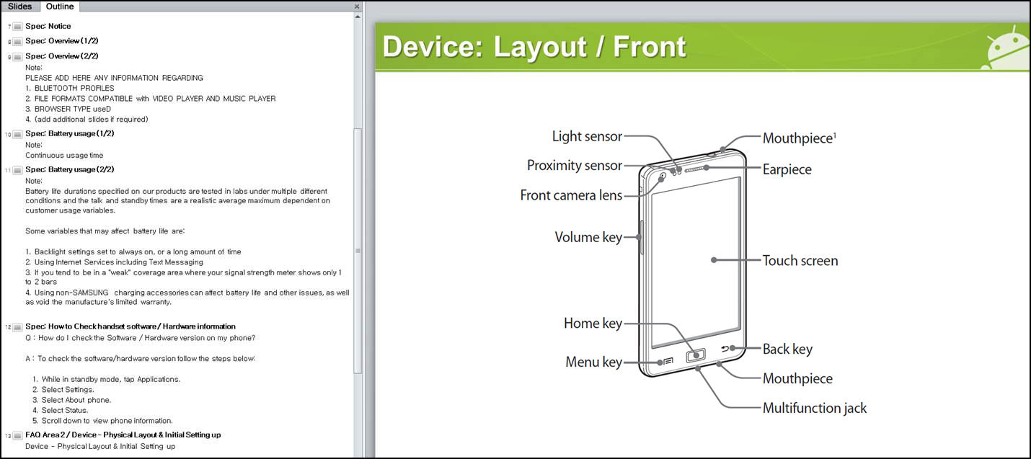
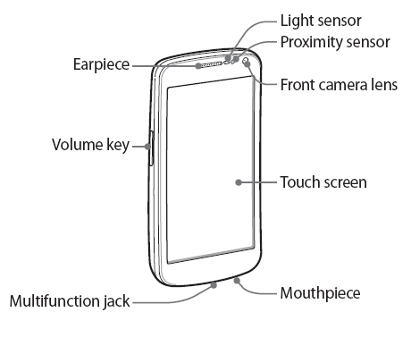
Use of OUTLINE feature of FAQ guide
In this FAQ guide, all slides have been titled so that slide name appears in the Outline Tap.
When using the guide open the Outline Tap and scroll up / down to help find the area you require

Slide 6
Spec: Notice
Notice:
All functionality, features, specifications and other product information provided in this document including,
but not limited to, the benefits, design, pricing, components, performance, availability, and capabilities of
the product are subject to change without notice or obligation. Samsung reserves the right to make changes
to this document and the product described herein, at anytime, without obligation on Samsung to provide notification of such change.

Slide 7
Introduction to this guide
Introduction: Ice Cream Sandwich - “ICS” (Android OS 4.0) upgrade for GT-I9100
This guide has been created to provide advice on:
> How to obtain the ICS update for the GT-I9100
> Observations regarding the update
> Advice regarding some of the key differences between Gingerbread OS and
Ice Cream Sandwich OS

Slide 8
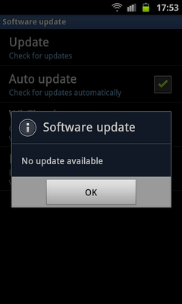
How to obtain the ICS update for the GT-I9100
Q. Can I upgrade my phone to Android SW version “Ice Cream Sandwich” (ICS)
via FOTA?
The ICS SW upgrade is not currently supported via
FOTA in some countries.
Note: If the customer is in a country where
there is currently no service to upgrade the
mobile device SW from Ginger Bread to
Ice Cream Sandwich via FOTA, a “No update
available” pop-up will be displayed.
Where there is no upgrade service via FOTA, please
try method below, (subject to ISC OS update
availability via KIES).
To upgrade your GT-I9100 to ICS version,
please try upgrading your mobile via KIES 2.0
You can download KIES 2.0 from www.samsung.com

Slide 9
Observations regarding the update 1/3
Q. Can I use Bluetooth 3.0 HS function in ICS version?
The Ice cream Sandwich OS feature does not support Bluetooth 3.0 HS (High
Speed) function
However Bluetooth 3.0 is supported.
If you want to transfer a file at a faster data rate between devices, you can use
Wi-Fi direct function. (where the other device supports this function)
Q. Can I see Adobe flash contents in web browser?
No - To view compatible Adobe Flash contents of a web page, please download
Flash player from Android “Play Shop”” (Previously known as Android market).

Slide 10
Observations regarding the update 2/3
Q. I use the exchange server account in my mobile and can not upgrade its OS to
ICS through Kies.
A. Some exchange server account requires the “device encryption” to connect to exchange server.
“Device encryption” limits the synchronization or firmware updating through Kies.
Please decrypt or initialize your mobile after data backup and try to upgrade again.

Slide 11
Observations regarding the update 3/3
Notes regarding initial differences and settings after ICD update
ICS (v4.0)
※ Wall paper and Widgets
The Wall Paper set prior to ICS update will revert back to the “default” setting
The Widgets set prior to the ICS update will be initialized
※ Application compatibility
- Some 3rd applications will not work in ICS OS
- If so, please advise customer they will need to advise 3rd party application developer
that an update to the app is required.

Slide 12
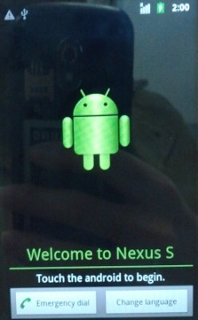
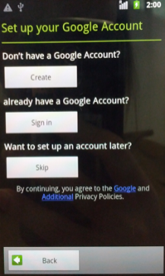
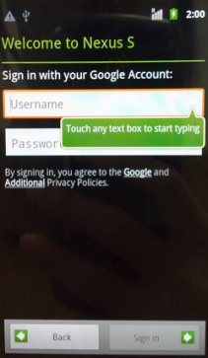
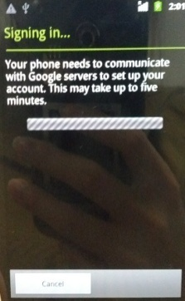
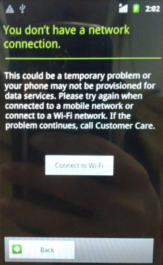
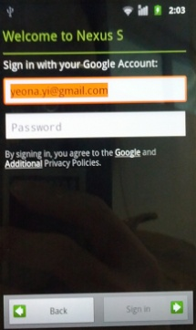
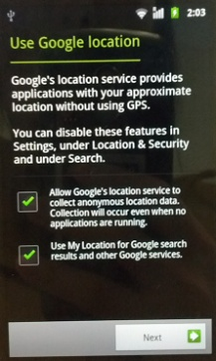
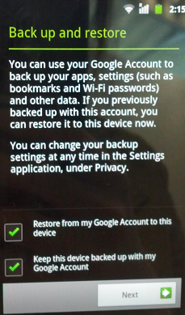
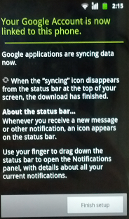
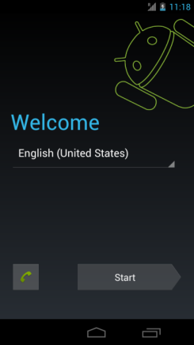
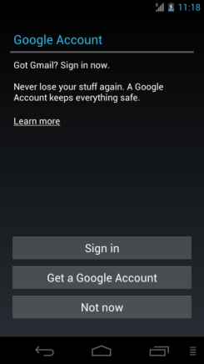
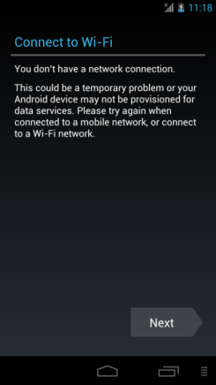
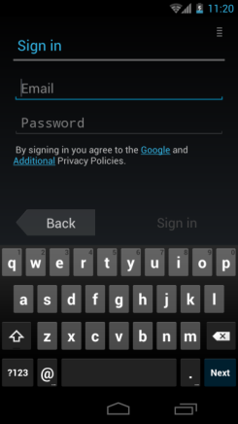
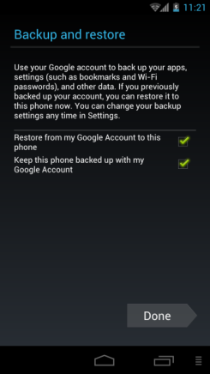
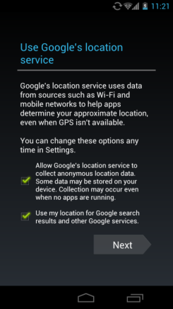
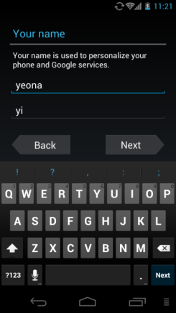
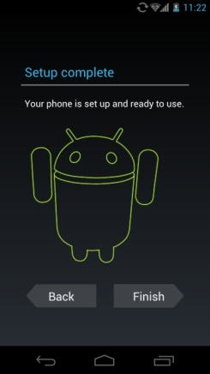
Setup Wizard 1/2
Gingerbread (v2.3.6)
Select language
Select Google
Account
Sign in
Google
Account
Sign in
Sign in fail
Connect Wi-Fi
Google
Account
Sign in
Location
Service
Agreement
Backup
& restore
Agreement
Setup completed
This STEP now removed
ICS (v4.0)
Select language
Select
Google
Account
Sign in
Connect Wi-Fi
Google
Account
Sign in
Select
Backup
& restore
Location
Service
Agreement
Input user name
Setup completed
This STEP Added

Slide 13
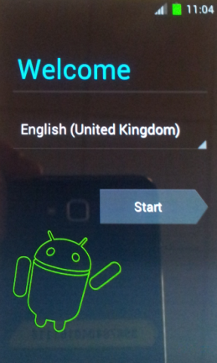
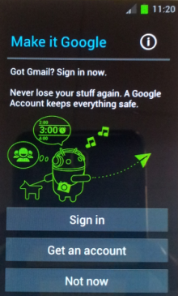
Setup Wizard 2/2
Note: The previous slide shows the Set Up wizard
pictures for a Generic ICS update.
Be advise that the Set Up wizard may vary depending
on region.
GOOGLE ACCOUNT:
Generic ICS setup wizard showing screen for setting up Google account
MAKE IT GOOGLE:
GT-I9100 ICS setup
wizard showing screen for setting up Google account

Slide 14
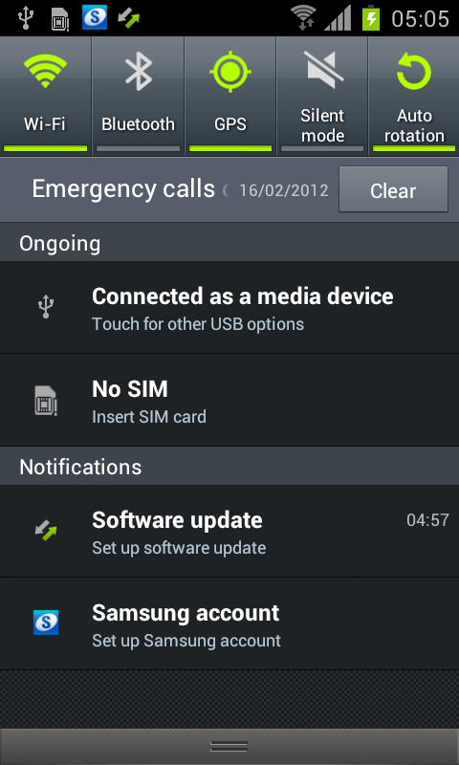
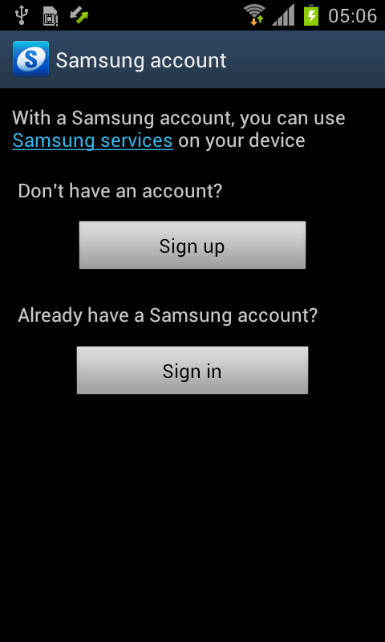

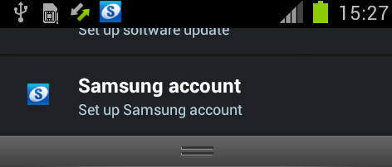
Samsung Account
※ “Samsung Account” Icon now added in notification panel*
ICS (v4.0)
Samsung Account
A Samsung account is used for identify
the user with regard to Samsung services such as Samsung Dive
Note: A Samsung Account is no longer required for the Samsung FOTA service
*Touch and hold on the bar at
the top of the screen and
then drag down to reveal
the drop Down menu
/ notification
panel
The Samsung Account notification icon is displayed after S/W upgrade or initialization
If you tap on the “Back” button when in this screen, the Samsung account icon will not display in notification bar

Slide 15
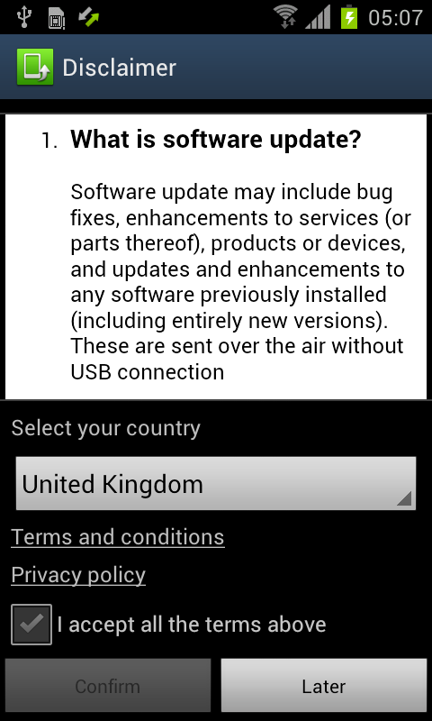
Home Screen – FOTA Service
※ “Software update” Icon now added in notification panel
ICS (v4.0)
Samsung FOTA Service
If you accept “Disclaimer”, your mobile
will check S/W version in Samsung
server and update to latest version where available.
Note: A Samsung Account is no longer required for the Samsung FOTA service
The Software update
notification icon is displayed after S/W upgrade or initialization
If you confirm this disclaimer,
Notification icon will be disappeared.
※ If you tap on “Later”, the screen it will change.

Slide 16
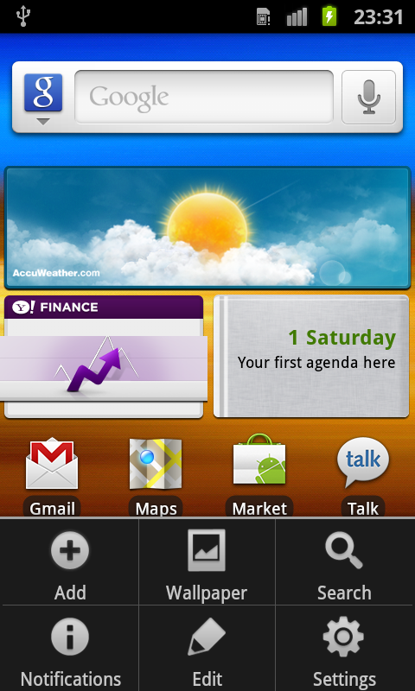
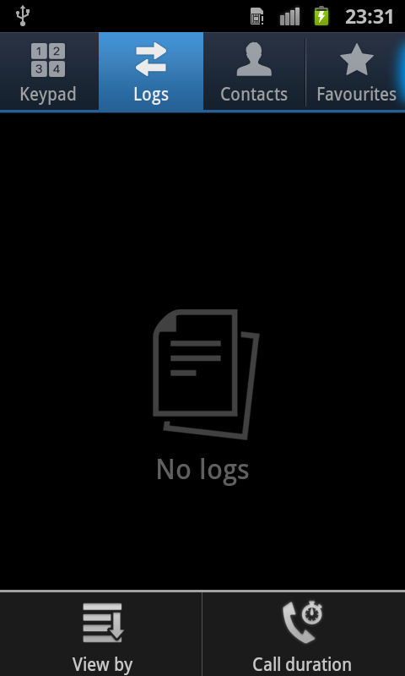
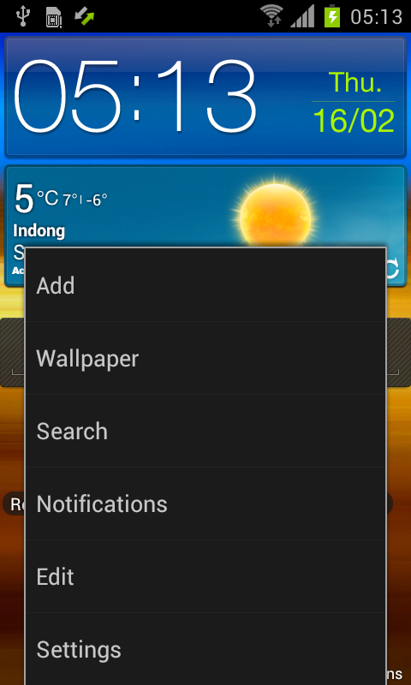
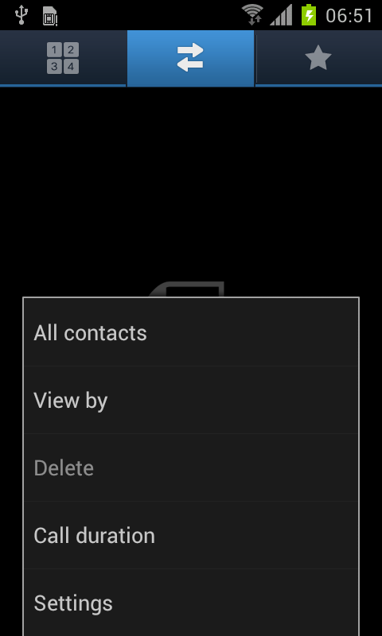
General – Menu Button (1/2)
※ Sub menu for Menu Button is changed
Gingerbread (v2.3.6)
ICS (v4.0)
Changed to
Sub menu for Menu Button is
changed from Grid format to List format
Grid format Sub menu for Menu Button

Slide 17
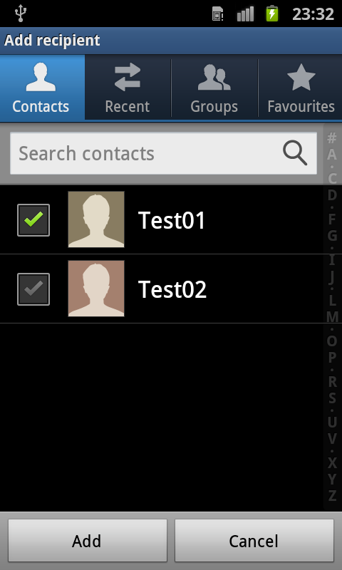
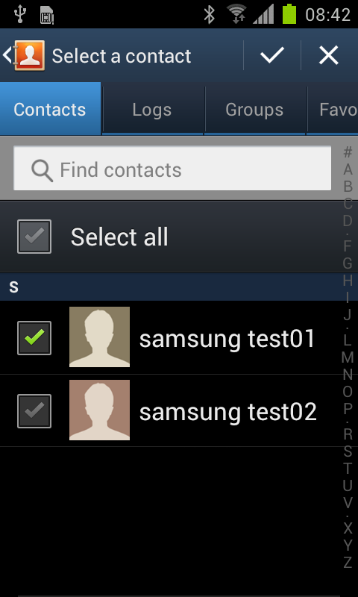
General – Menu Button (2/2)
※ Sub menu for Menu Button is changed
Gingerbread (v2.3.6)
ICS (v4.0)
Add and Cancel located at the
bottom of the screen
Changed to
Add and Cancel located at the
top* of the screen
*Many buttons( like “Add”, “Cancel”) are now moved from bottom
of screen to the top

Slide 18
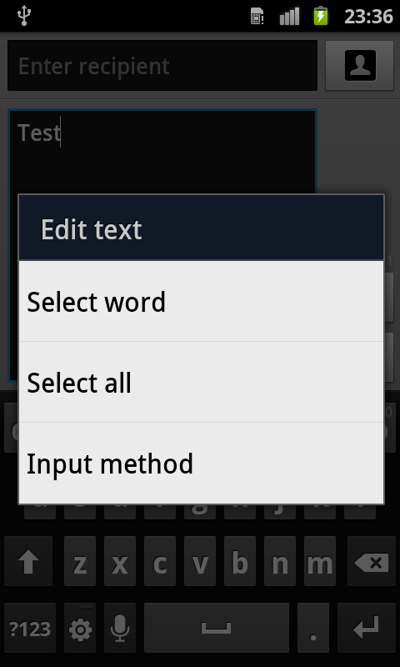
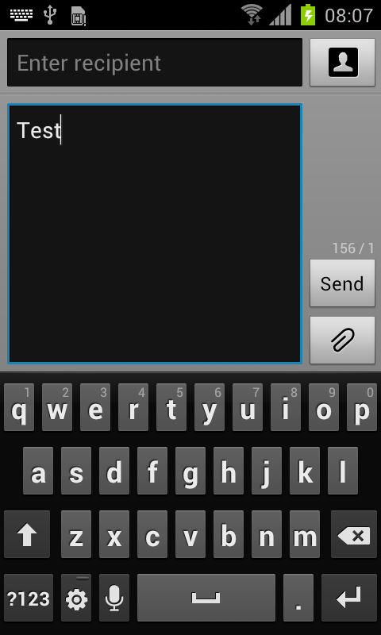
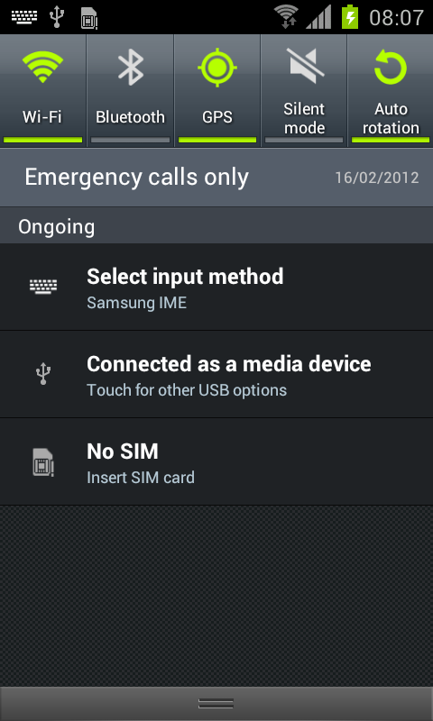
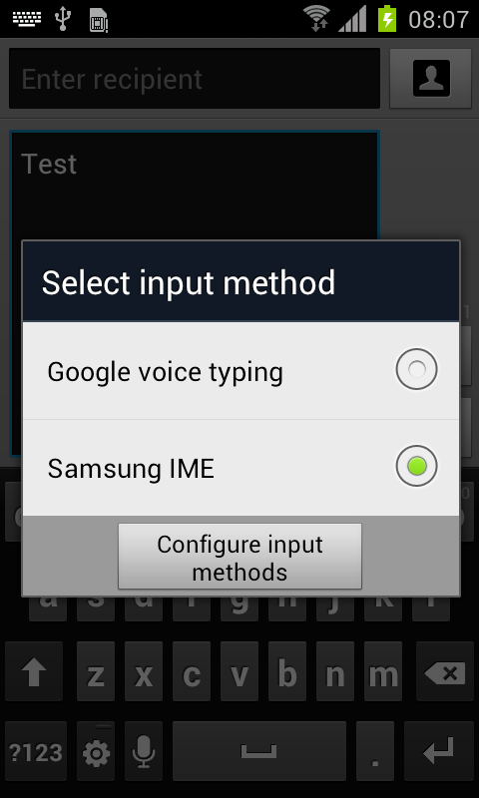
General – Input Method 1/2
※ How to select Input method process is changed
Gingerbread (v2.3.6)
ICS (v4.0)
Click and hold in “Input screen”
1. Keyboard Icon is added in indicator bar
2. Select “Select input Method”
(drag down the Notification screen first)
3. Change or configure input method
SEE NEXT SLIDE
Changed to

Slide 19
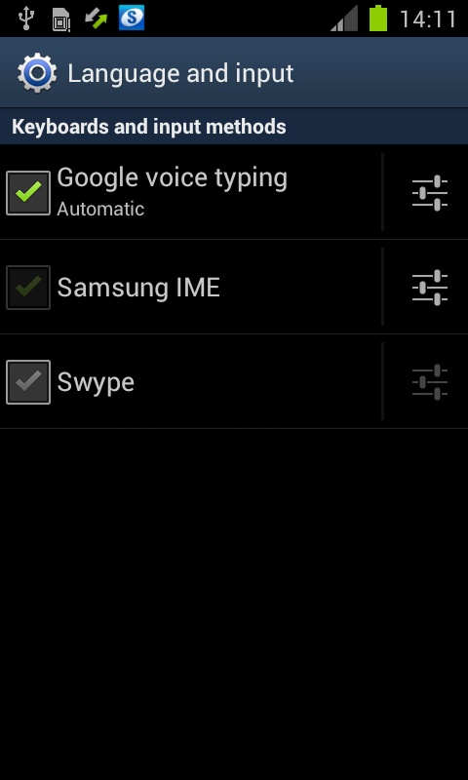
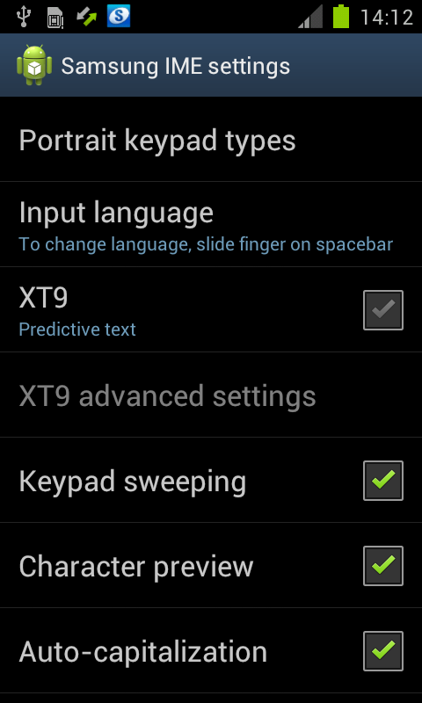
General – Input Method 2/2
ICS (v4.0)
4. Tap in the settings icon box next to Samsung IME*
5. You can now configure the Samsung IME settings
*IME – Input Method Editor

Slide 20
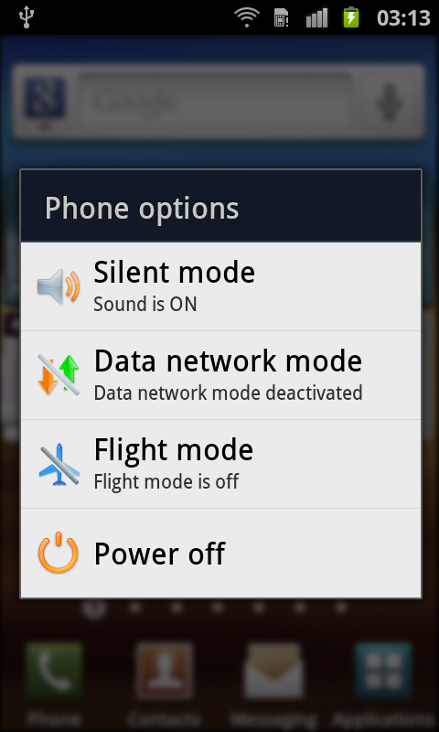
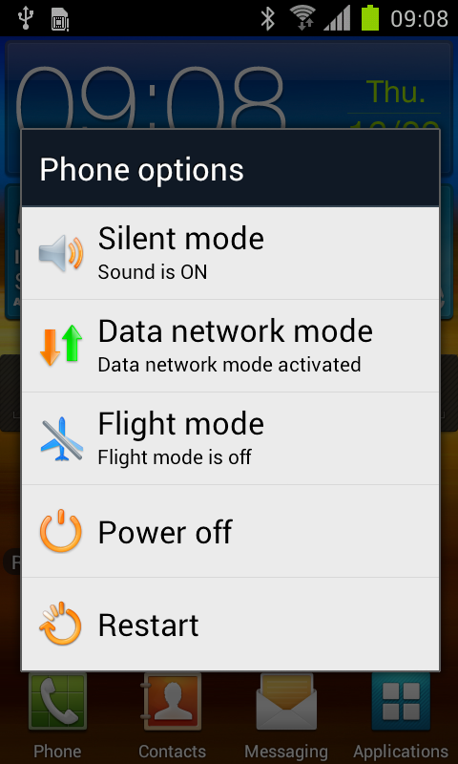
General – Power
※ “Restart” now added
Gingerbread (v2.3.6)
ICS (v4.0)
Changed to
Options shown when
you press power button for a
few seconds
“Restart” option is added when
you press power button for a
few seconds

Slide 21
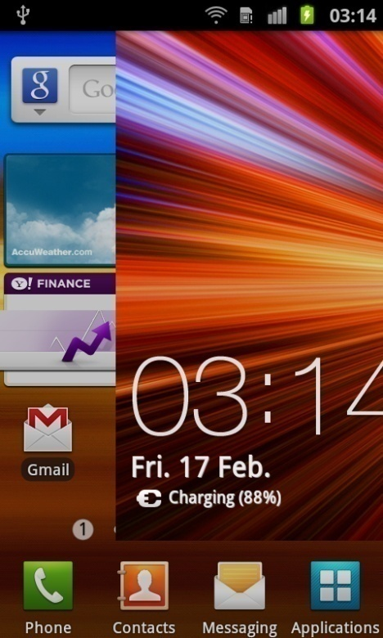
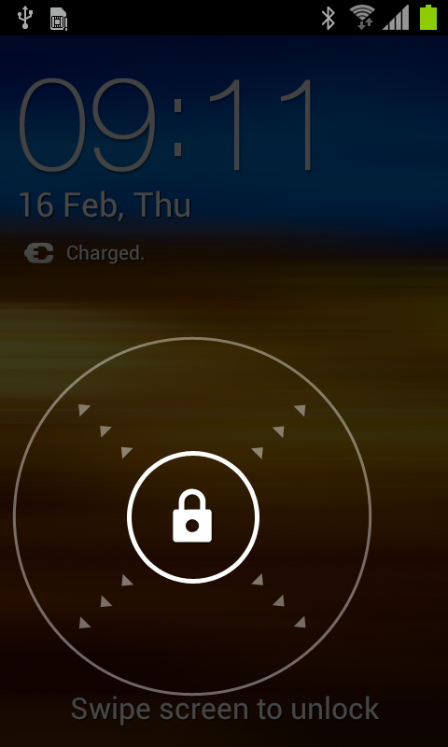

General – Slide Lock
※ To unlock slide lock, touch and drag to outside of circle
Gingerbread (v2.3.6)
ICS (v4.0)
To unlock slide lock, touch and drag “Lock screen”
To unlock slide lock, touch and drag to outside of circle
Changed to

Slide 22
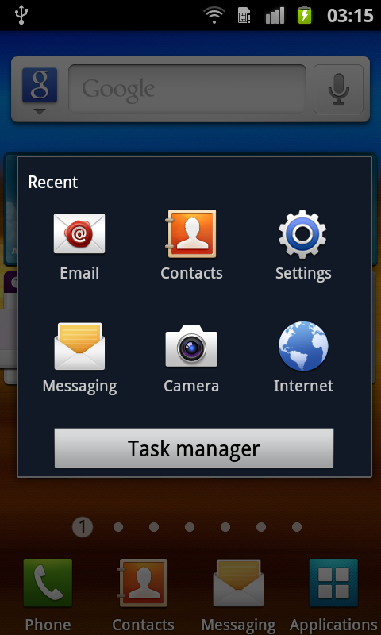
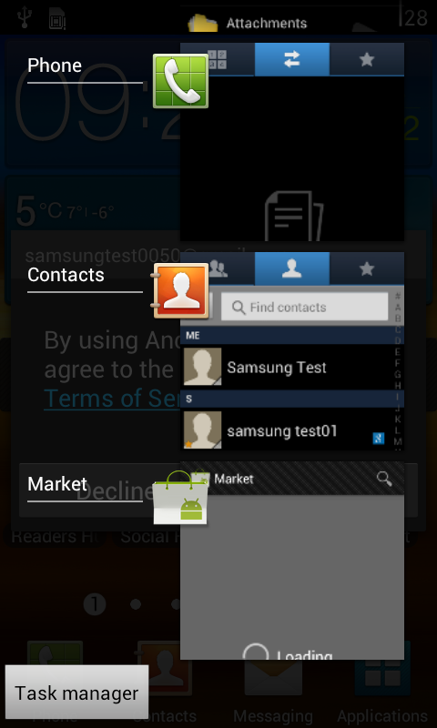
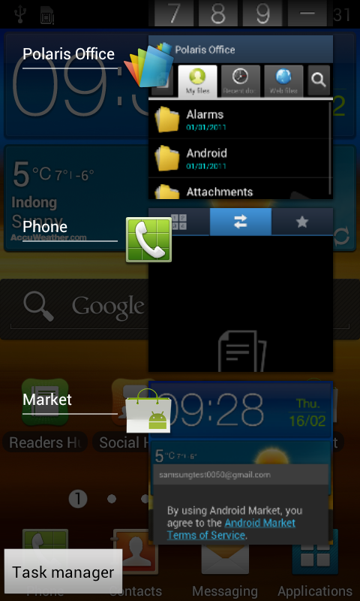
General – Recent
※ Recent application display UI is changed
Gingerbread (v2.3.6)
ICS (v4.0)
If you press “Home” button for a few seconds, recent applications are displayed.
If you press “Home” button for a few seconds, recent applications are displayed.
If you want to remove an application in recent list, select and drag to right or left side
Changed to

Slide 23
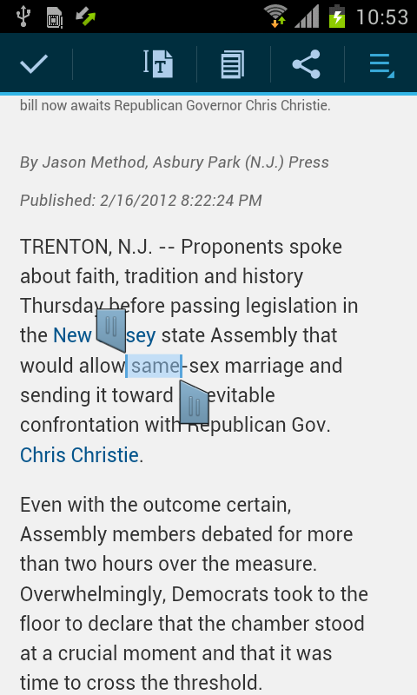
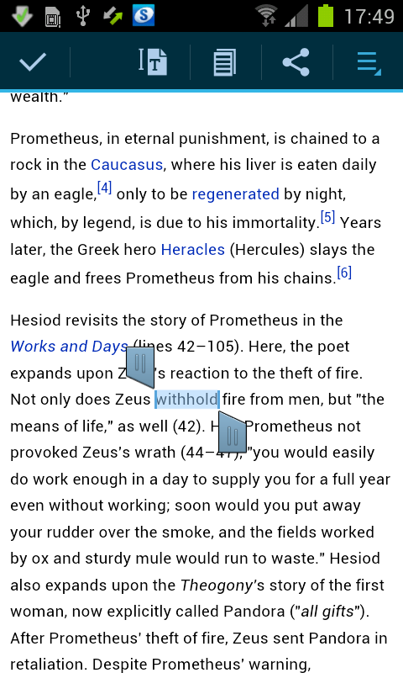
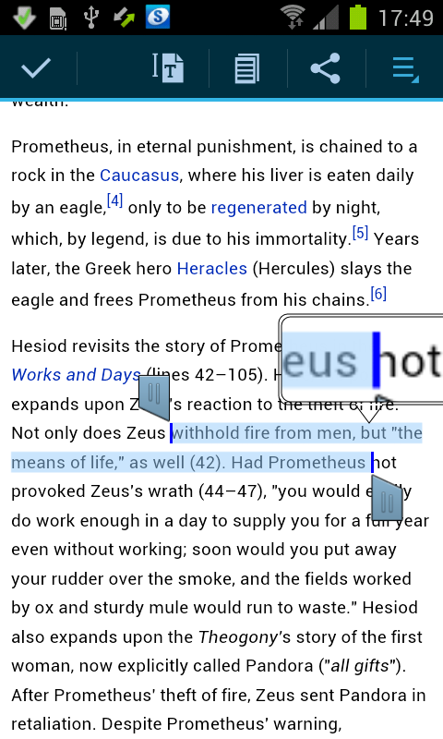
General - Text Selection 1/3
※ Text selecting options are moved to the top of screen
ICS (v4.0)
Example below shows Text selection when using WEB browser
If you touch and hold
In the area of the text
on the screen of the web browser 4 icons will be
displayed at the top
If you touch and hold one of the icons next to the highlighted test you can drag across the screen to expand the highlighted text selection.

Slide 24

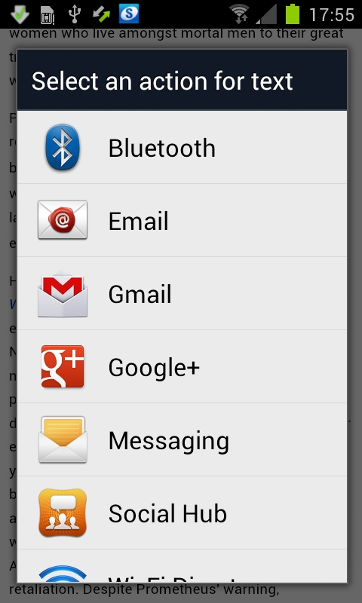
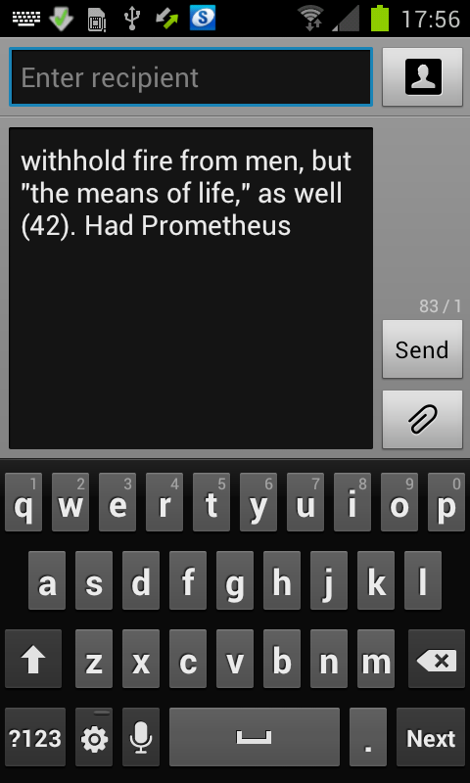
General - Text Selection 2/3
※ Text selecting options are moved to the top of screen
ICS (v4.0)
Example below shows Text selection when using WEB browser
Tap on the Share icon to enable selected texts to be used by other applications e.g. Messaging
Selected text automatically pasted into the
Messaging Text box

Slide 25






General - Text Selection 3/3
※ Text selecting options are moved to the top of screen
ICS (v4.0)
All text is selected
Selected text copied to clipboard
Further functions available
Find text or search them in Internet

Slide 26


Call – Icon, Contacts
※ Call / Phone Menu User Interface (UI) now changed
Gingerbread (v2.3.6)
ICS (v4.0)
Changed to
Phone “menu” changed.
Description for each tap and contacts tab are removed
Phone “menu”
Contacts Tab removed

Slide 27


Call – Favorites
※ Thumbnail used to display contacts in Favorites
Gingerbread (v2.3.6)
ICS (v4.0)
Contacts added to Favorites
Shown in Rows
Changed to
Favorites now shown as a Thumbnail with Contact name added in the thumbnail view

Slide 28


Contacts – Save contact to
※ “Save new contacts to” option removed
Gingerbread (v2.3.6)
ICS (v4.0)
Changed to
“Save new contacts to” options now removed
Contacts Settings - “Save new contact to” option available

Slide 29


Message – Select a contact Icons
※ Contact, Logs Icons now removed in “Select a contact” function
Gingerbread (v2.3.6)
ICS (v4.0)
Icons displayed for Contacts / Recent (Call logs) Groups of Contacts., Logs
Icons now removed for Contacts / Recent (Call logs) Groups of Contacts., Logs
Changed to

Slide 30


Application – Unknown sources
※ “Unknown sources” option is moved from Applications to Security
Gingerbread (v2.3.6)
ICS (v4.0)
The setting to allow installations of applications not downloaded from Android Market (or Play) “Unknown sources” option located in Applications Settings
“Unknown sources” option is moved from Applications to Security
Changed to

Slide 31




Setting – Settings
※ Settings for Wireless and Network re-organised
Gingerbread (v2.3.6)
ICS (v4.0)
In settings area access to Wi-Fi Settings / Bluetooth and network settings are access via “Wireless and Network”
Wi-Fi/BT ON/OFF buttons are displayed instead of “wireless and network”
Data usage function now added
To access other network settings, click “More…”
Settings are categorized
(Wireless & networks, Device, Personal, System)
Category name is changed (Privacy→Backup&reset)
Changed to

Slide 32


Network Setting – Potable hotspot
※ Additional security option added
Gingerbread (v2.3.6)
ICS (v4.0)
※ WPA (Wi-Fi Protected Access)
WPA
- Pre shared Key (PSK)
- can use 802.1X authentication (EAP via RADIUS)
NOT SUPPORTED: TKIP encryption
- a possibility to use a form of AES-CCMP if the chipset on the network card, client supplicant, and router all support it
WPA2
- Pre shared Key (PSK)
- can use 802.1X authentication (EAP via RADIUS)
- TKIP encryption retained for backwards compatibility
NOT SUPPORTED: AES-CCMP encryption
Changed to
Open and WPA2 PSK
options available
In Potable hotspot security option, “WPA PSK” is added

Slide 33




Network Setting - VPN
※ Lock setting is needed to use VPN
Gingerbread (v2.3.6)
ICS (v4.0)
PIN or Pattern lock is not needed to access VPN options
To use VPN network, Lock screen PIN or Password
must be activated first
Changed to

Slide 34



Setting – Display
※ Display settings access now changed
Gingerbread (v2.3.6)
ICS (v4.0)
“Screen display” options (such as Font Style, Wallpaper etc) are accessed by entering the Display* area in Settings, then tapping on Screen display
* To start tap Applications > Settings > Display > Screen display > the screen display settings available will be listed
“Screen display” options available are now listed in the main display settings area
To start tap Applications > Settings > Display > the screen display settings available will be listed
Changed to

Slide 35



Setting – Applications
※ Process to access “Manage applications” changed
Gingerbread (v2.3.6)
ICS (v4.0)
Options to “Manage applications” are accessed by process below:
To start tap Applications > Settings > Applications > Manage Applications > the screen will appear to manage your applications
Options in “Manage applications” are moved to “Applications”
To start tap Applications > Settings > Applications > the screen will appear to manage your applications
Changed to

Slide 36



Setting – Developer options
※ Process to access “USB debugging” changed
Gingerbread (v2.3.6)
ICS (v4.0)
USB debugging accessed via:
USB debugging and Allow mock locations options are moved to “Developer options”
To start tap Applications > Settings > Applications > Development >
the screen will appear enable you to set USB debugging
To start tap Applications > Settings > Developer Options >
the screen will appear enable you to set
USB debugging
Changed to

Slide 37


Setting – Auto rotation
※ Access to “Auto rotation” setting now moved to Accessibility settings area
Gingerbread (v2.3.6)
ICS (v4.0)
“Auto-rotation screen” setting located in “Display “setting
“Auto-rotation screen” setting is moved to Accessibility
To start tap Applications > Settings > Display >
the screen will appear enable you to set Auto Screen rotation
To start tap Applications > Settings > Accessibility > the screen will appear enable you to set Auto Screen rotation
Changed to

Slide 38

Screen lock – None
※The option “None” now added in Screen lock setting
ICS (v4.0)
The “None” option now added in Screen lock settings area
None is no screen lock and enter to home screen
There are 6 kinds of screen lock:
None / Slide / Face Unlock / Pattern / PIN / Password
To start tap Applications > Settings > Security > Screen Lock > the screen will appear enable you to set the Screen Lock type

Slide 39




Screen lock – Face
※ “Face Unlock” feature now added in Screen lock setting
ICS (v4.0)
Select “Face Unlock” in
Screen lock setting
Allow your face to be seen using the front camera and adjust position of handset until your face is located in the circled area
Configure Patten or PIN to unlock your device when you have difficulty using “face unlock”
If you have trouble in “face unlock”, tap the “Lock” Icon and input the previously set up pattern or PIN
※ To use pattern lock, you must select over 4 points (see next slide re use of Pattern lock)

Slide 40

Screen lock – Fail count
※ Lock setting is needed to use VPN
ICS (v4.0)
If you select three incorrect points or less in pattern lock screen, it’s not counted.
(If you select 4 point or more over 5 times in succession , you must wait 30 seconds to input pattern again)
※ To use pattern lock, you must select over 4 points

Slide 41
Appendix
Appendix

Slide 42


Tips – Screen Capture
※ Key combination for perform screen capture now added
Gingerbread (v2.3.6)
ICS (v4.0)
Power
Volume Down
Power
Home
※ Screen capture Key combination
- Press and hold Volume Down + Power
※ Screen capture Key combination
- Press and hold Home + Power
After screen capturing, screen capture icon is displayed in indicator bar
Please note: the previous key combination
(“ Home + Power “)
can still be used.

Slide 43
Application – Google +
Q. When I try to use Google + after upgrading my device to ICS OS (Ice Cream
Sandwich), Google + is not working correctly. What should I do?
This issue happens when using Google + Version v2.3.1 and resolved in latest version of Google + (v 2.4.1 or over)
You can update Google + by downloading the application from Google “Play” (Google “Play” is the new updated version of Android “Market”.
※ latest version of Google + will be included in future versions of the ICS update

Slide 44
Settings – Initialized values after updating
Q. I after I updated my GT-I9100 to ICS OS (Ice cream sandwich) some settings are changed. What has happened?
During the process of updating your GT-I9100 device to “ICS” OS some personal setting are initialized (or reset). The major changes are below
- Home URL initialization (Home page for Internet Web Browser)
- Added personal APN removal (APN – Access Point Name)
- Home screen initialization
- Music playlist removal
- Main menu initialization
- Email Premium account removal
- IM account removal (Instant Messenger)

Slide 45
Bluetooth – SAP Profile unavailable
Q. After I updated my GT-I9100 from Gingerbread OS to ICS OS (Ice cream sandwich operating system), my phone does not connect via Bluetooth to my car (Car Kit). What should I do?
The ICS OS does not include the Bluetooth profile “SAP” (SIM Access Profile).
So if your mobile was connected with your car through Bluetooth “SAP”, you need to re-initialize the connection and try to pair again.
Please delete the paring information about your mobile in Bluetooth car kit and
try to pair your mobile and Bluetooth car kit again.
Note 1:
ICS OS does not support Bluetooth Profile “SAP” but does support Bluetooth Profiles “PBAP” and “HFP”.
Bluetooth profiles “PBAP” and “HFP” share some of “SAP” ‘s functions.
(See next slide for more information regarding Bluetooth profiles)
Note 2: Although ICS OS does not currently support “SAP”, Samsung is looking into how this
profile can be added in future SW updates.

Slide 46
Bluetooth – SAP Profile unavailable
Bluetooth Profile :
A Bluetooth profile is a specification that defines the minimum requirements that the
Bluetooth device must support in a specific usage scenario.
These requirements define the end-user services and the features and procedures that the Bluetooth device must support to enable interoperability with peer devices.
SIM Access Profile (SAP) :
SIM Access Profile is a Bluetooth profile allowing a Mobile device with “SAP” profile to share its SIM card with another device of the same type.
PBAP: Phone Book Access Profile
PBAP is a Bluetooth profile that allows exchange of Phone Book Objects between devices
Hands Free Profile: HFP
HFP is a Bluetooth profile that enables a Mobile device to send and receive calls
with a hands-free device.

Slide 47
Application – Smart View
Q. I installed the “SMART View” app on my GT-I9100 device and after I updated my GT-I9100 to ICS OS (Ice cream sandwich), the “Dual View” mode of the “Smart View” app is not working in my
mobile. What should I do?
The current version of ICS installed on your device does not support “Dual view” .
However this will be corrected for the next S/W release for your mobile
.
Please keep checking for updates to your mobile operating system for when the new S/W version is released.
※ Note 1: The Remote control function of Smart View is still working in ICS version. (only dual view is not working.)
Note 2: SMART View is Wi-Fi remote control application for Samsung Smart TV. Link to app below from Google “Play”
https://play.google.com/store/apps/details?id=com.samsung.smartview&feature=search_result#?t=W251bGwsMSwxLDEsImNvbS5zYW1zdW5nLnNtYXJ0dmlldyJd
Note 3 : What is Dual View?
You can enjoy TV and other multimedia right from your mobile device that’s connected to a Samsung
Smart TV. You can even send what you’re watching on your mobile device to a TV and watch it from the TV.

Slide 48
END
Customer Consultant Guide
Android mobile technology platform
Global CS
ECC HHP Review
Country : Europe
Language : English

